Slide 1
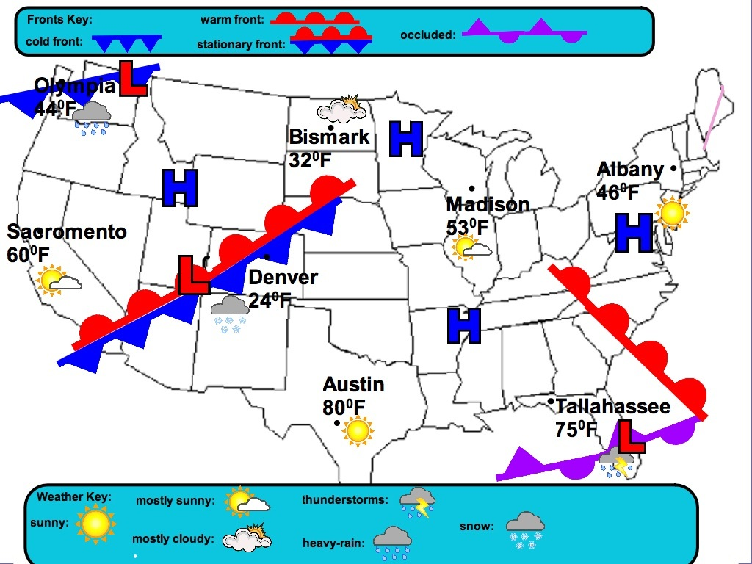

Slide 2
Weather Predictions
What is the weather like in the following areas right now?
Sacramento
Denver
Olympia
Create a five-day forecast for weather in the following areas:
Raleigh, NC
Nashville, TN
Miami, FL
Columbia, SC

