Slide 1
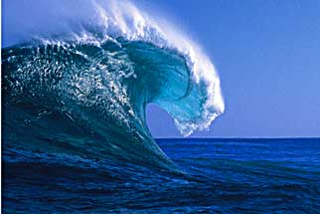
Ocean Movements
Ocean Currents, Waves and Tides

Slide 2
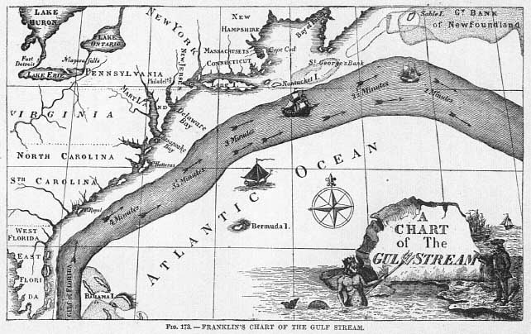
Ocean currents: move water from place to place.
Probably the first one discovered was the Gulf Stream (1769). It is 100 m wide and was observed to make travel America to England faster and was described as a river in an ocean.

Slide 3
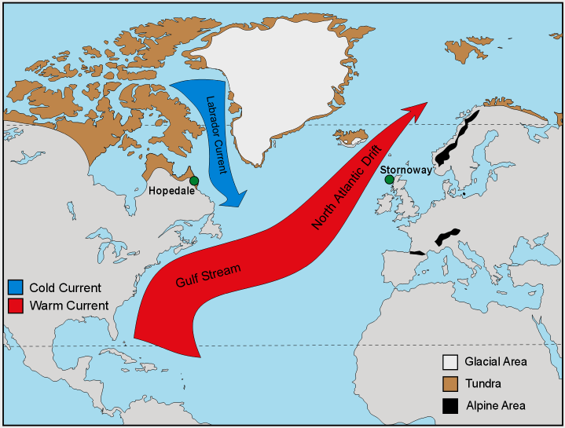
Benjamin Franklin named it the Gulf Stream because it flows out of the Gulf of Mexico.
It only affects the upper few hundred meters of seawater and is called a SURFACE CURRENT.

Slide 4
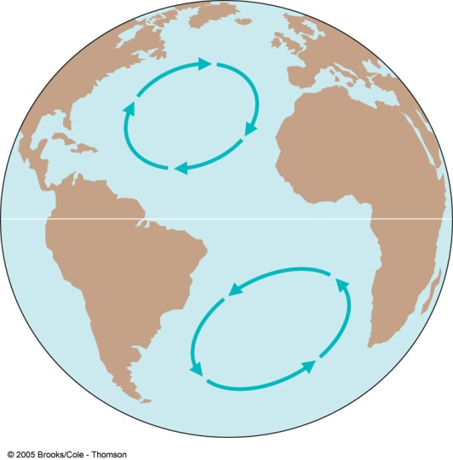
Surface currents
Most are caused by winds where there is friction b/n the windblown air and the water surface causing the water to move.
Ex. Surface currents in the tropics are pushed by the energy from the trade winds.
The Coriolis Effect (b/c of the Earth’s rotation) cause currents N. of the equator to move CLOCKWISE and most currents S. of the equator to move COUNTERCLOCKWISE.
gyre
https://www.youtube.com/watch?v=gsXiEy2kbGM trash in gyres 10 min start at 1;15
http://www.classzone.com/books/earth_science/terc/content/visualizations/es1904/es1904page01.cfm (skip)

Slide 5
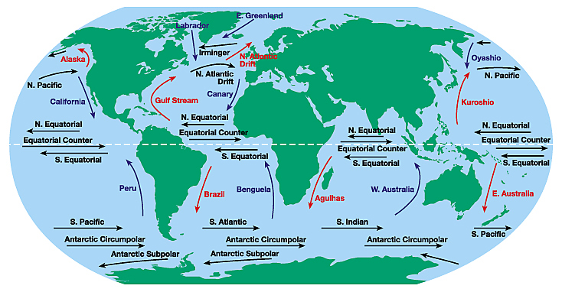
Global Surface currents

Slide 6
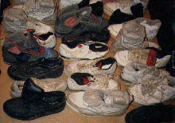
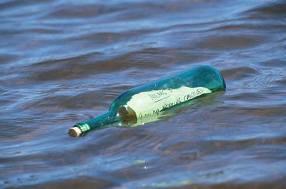
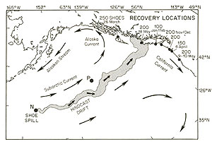
Great Sneaker Spill of 1990 (80, 000 sneakers)
On January 10, 1992, 28,800 plastic tub toys — turtles, ducks, beavers, and frogs— fell overboard in the mid-Pacific upcurrent of the sneaker spill.

Slide 7
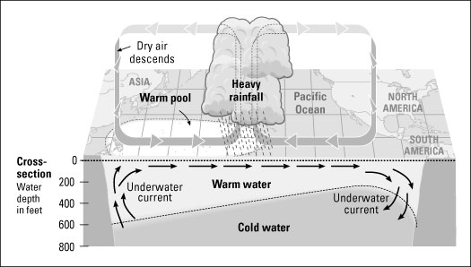
Weather's Sibling Rivalry El Niño and La Niña
Disruption of ocean currents that leads to short term climate change.
How does El Nino form?
A warm water current flows (from the Western Pacific) over a normally cold water current (Peru Current) off the coast of South America.

Slide 8
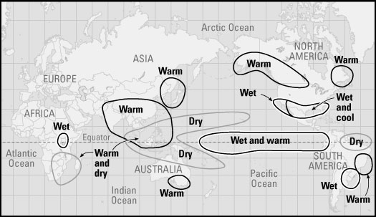
How does this change the climate?
Causes some areas to be drier, other areas to have more rain and violent storms. Some areas have a warmer than normal winter.

Slide 9
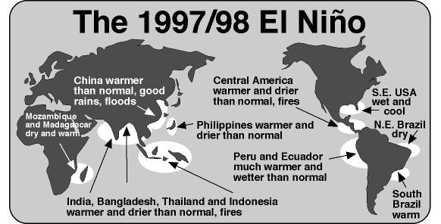
El Nino can occur every 2-10 years and the results are never identical.

Slide 10
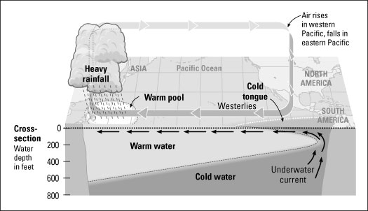
What about La Nina?
Works the opposite way… deeper cold water flows to the surface for a longer distance along the equator.

Slide 11
La Nina brings more cold, snow and rain than usual in the winter. Some areas become drier.
Example: El Nino could cause the SW United States to be cooler and wetter than normal. La Nina would cause the same area to be drier and warmer than normal.
https://www.youtube.com/watch?v=xJ451kbAvlg (4 min)

Slide 12
Density currents
https://www.youtube.com/watch?v=Mwnwvbcd8G8 Temp ex
Occur when denser seawater moves to an area of less dense seawater.
Denser (cold) water near the N. and S. Poles sink and travel along the ocean floor.
At the same time less dense (warmer) water at the equator rise.
(And) Moves toward the poles along the surface creating a cycle that circulates ocean water.
https://www.youtube.com/watch?v=I8kToTROCHA temp and salinity ex

Slide 13
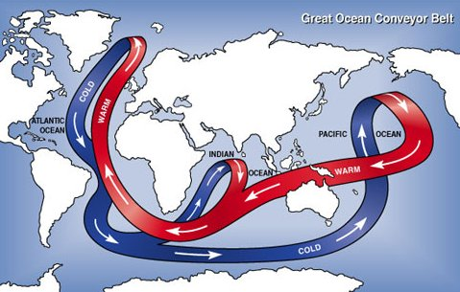
Global Conveyor Belt

Slide 14
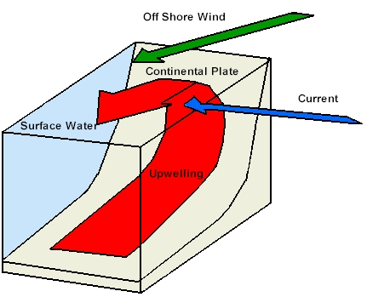
Upwelling
(B) In some places, cold water from deep in the ocean can rise to the surface (upwelling) when strong surface current carry water away from an area.
(1) Upwelling bring high concentration of nutrients to the surface from organisms that had died and sank.

Slide 15
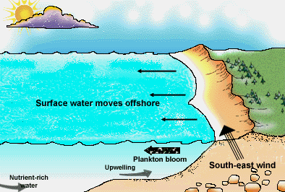
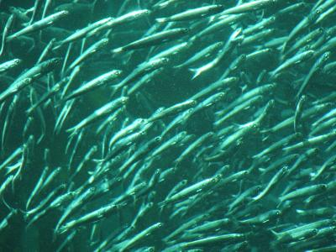
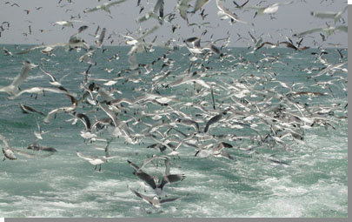
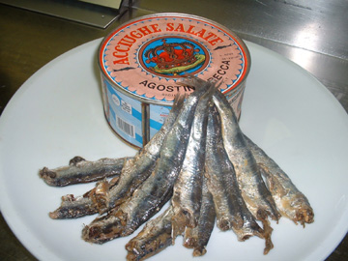
Upwellings

