Slide 1
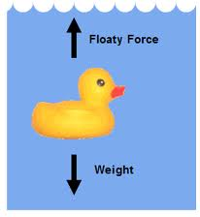
I. Life in the ocean
The ocean provides aquatic organisms with
Buoyancy (move easier)
SLOW temperature changes
Abundant supply of water
and rich nutrients
(from dissolved wastes).

Slide 2
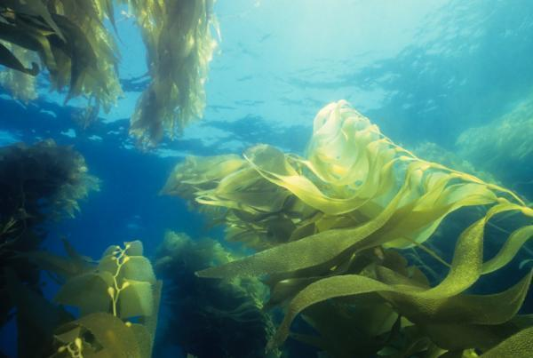
II. Important gases like CO₂, N, and O₂ are also found in seawater.
A. Plants and autotrophic (make their own food) organisms use CO₂, sunlight and water to produce food and oxygen.
6 CO₂ + 6 H₂O + light energy → C₆H₁₂O₆ + 6O₂
* Photosynthesis**

Slide 3
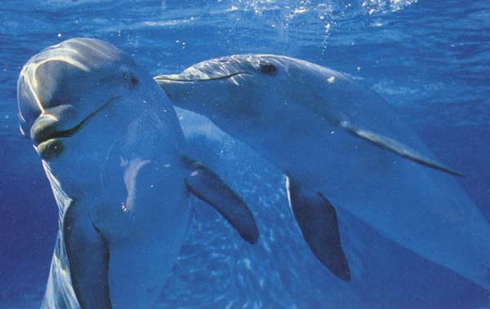
B. Respiration: Oxygen is combined with food so energy can be used.
C₆H₁₂O₆ +6O₂ →6 CO₂ + 6 H₂O + energy

Slide 4
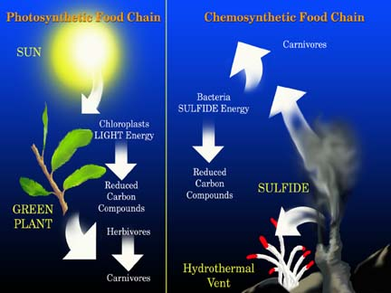
C. Another way to obtain energy that does not involve sunlight is chemosynthesis.
Bacteria produce food and oxygen by dissolving sulfur compounds that escape lava in rift zones.

Slide 5
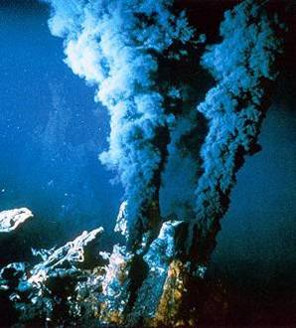
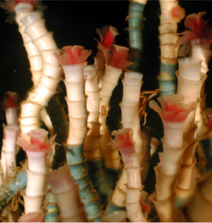
Chemosynthesis in action
http://video.nationalgeographic.com/video/hydrothermal-vents
Chimneys spewing super-hot fluid create a unique environment along the ocean floor. Here, countless giant tubeworms flourish.
Tube worms

Slide 6
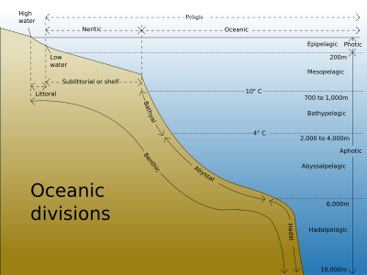
III. Ocean life
Divided into plankton, nekton and benthos and they live in all environmental zones.

Slide 7
Group | Example(s) | Where
Plankton
Nekton
Benthos |  | Anywhere on the bottom of the ocean floor from the intertidal zone to the deep rift zones/trenches.
http://www.youtube.com/watch?v=ngaTk1WLpyE Baby Shamu being born.
http://www.youtube.com/watch?v=p7txP9MOCqs Manatee – The Gentle Giants

Slide 8
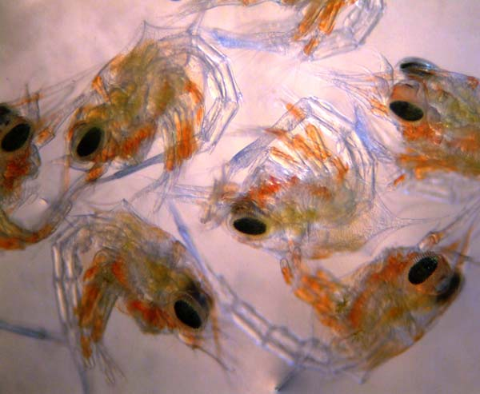
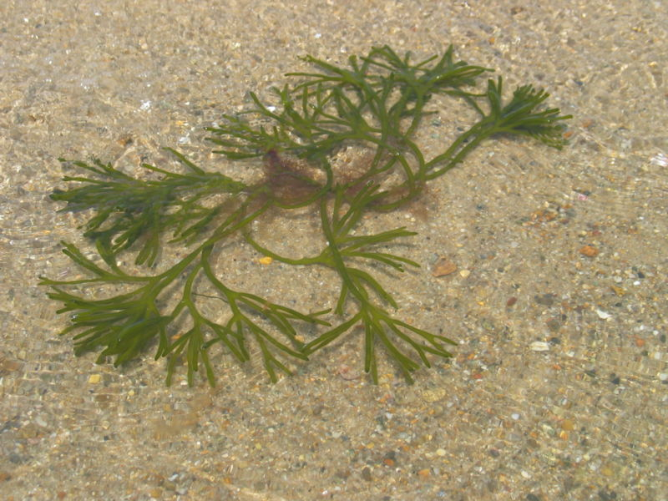
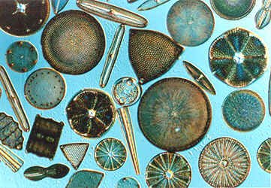
Plankton 2 kinds
*Plant like
Zooplankton :Animal like crab larvae
Phytoplankton:
Intertidal Zone: Sea weed

Slide 9
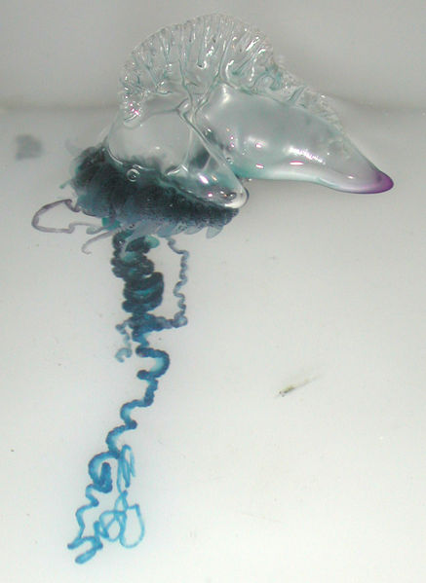
Portuguese Man-O-war
Plankton life group FLOATS in the surface zone.

Slide 10
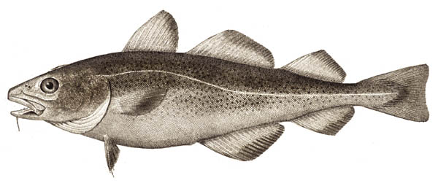
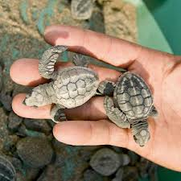
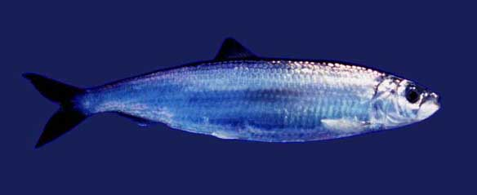
Nekton: swim freely between all 3 zones.
True eel
cod
Herring

Slide 11
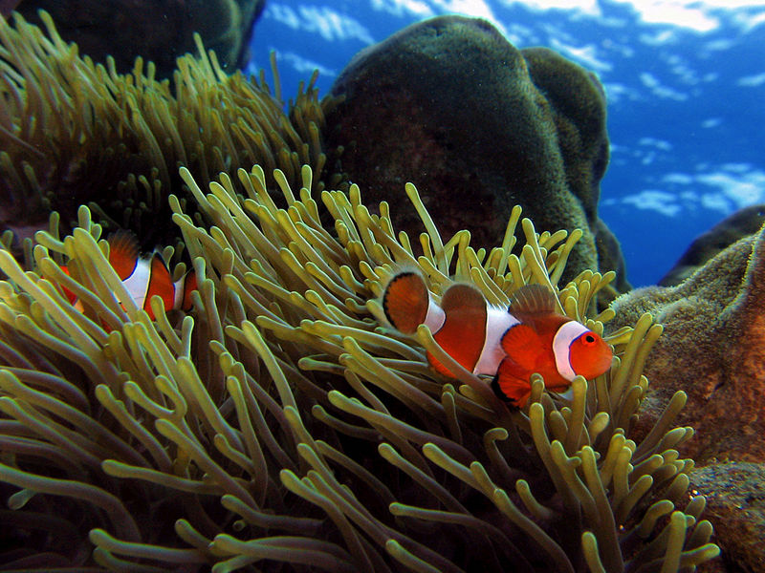
Clownfish and sea anemone

Slide 12
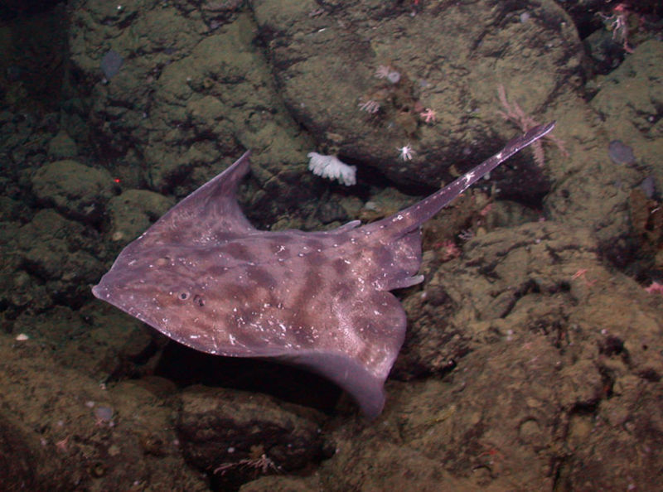
Neritic Zone: Skate (nekton)

Slide 13
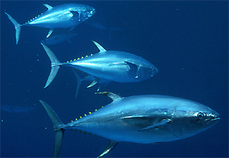
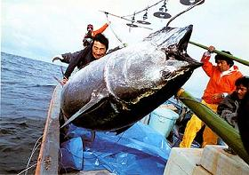
Yellowfin tuna

Slide 14
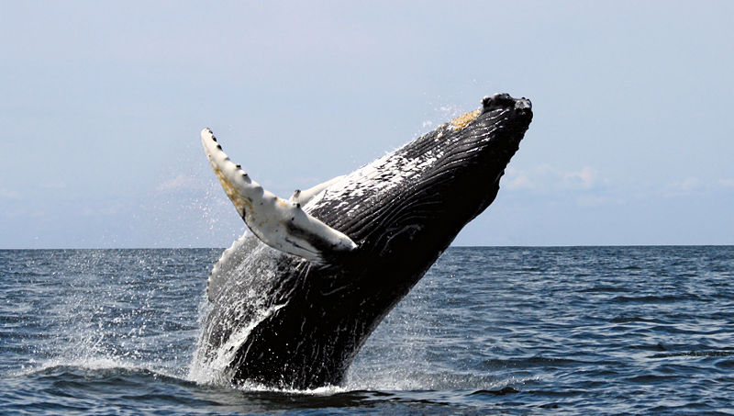
Open Ocean Zone Nekton
Humpback whale

Slide 15
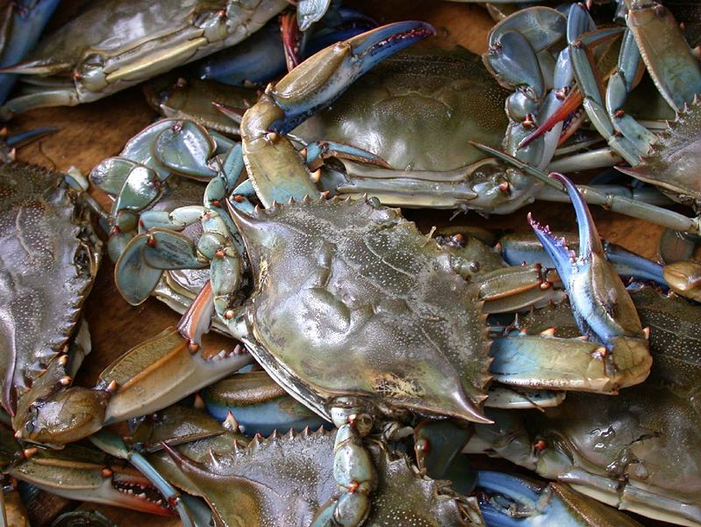
Blue Crab

Slide 16
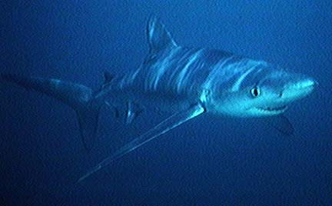
Bathyal Subzone Nekton
Blue Shark

Slide 17
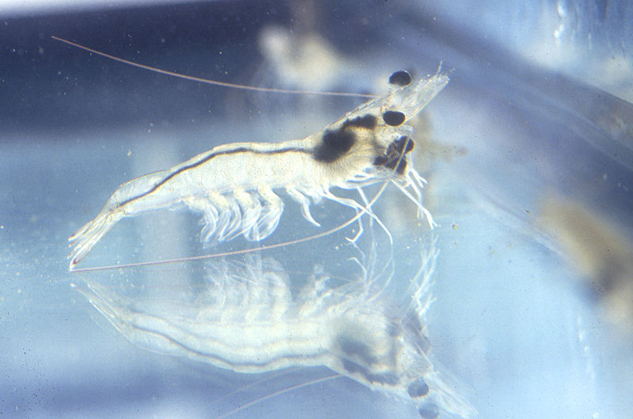
Shrimp

Slide 18
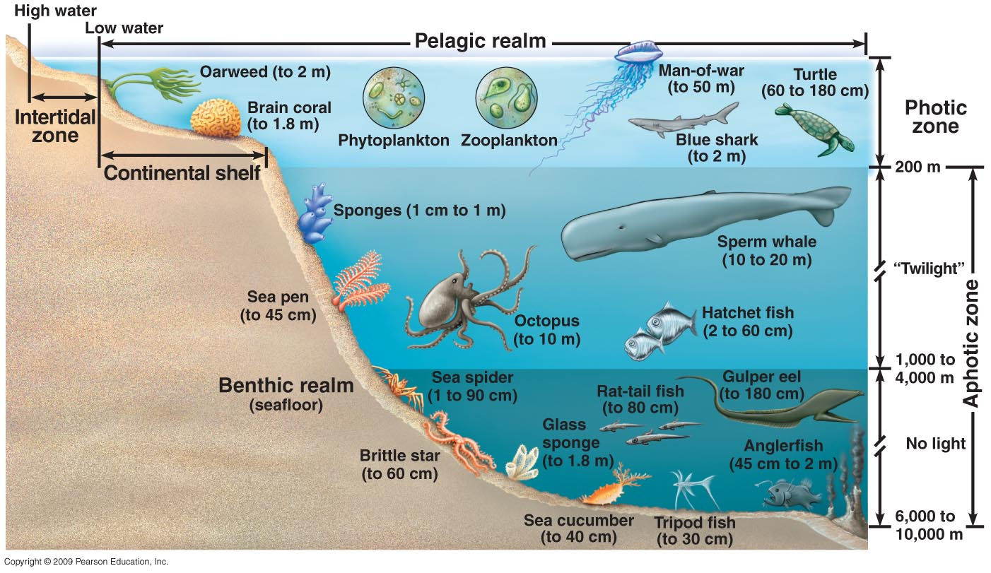
Benthos
Bottom of the ocean floor; Meaning any where from the continental shelf to the abyssal plain …

Slide 19
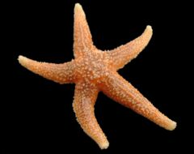
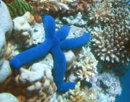
Intertidal Zone on Continental Shelf (benthos)
Common sea star
Blue sea star

Slide 20
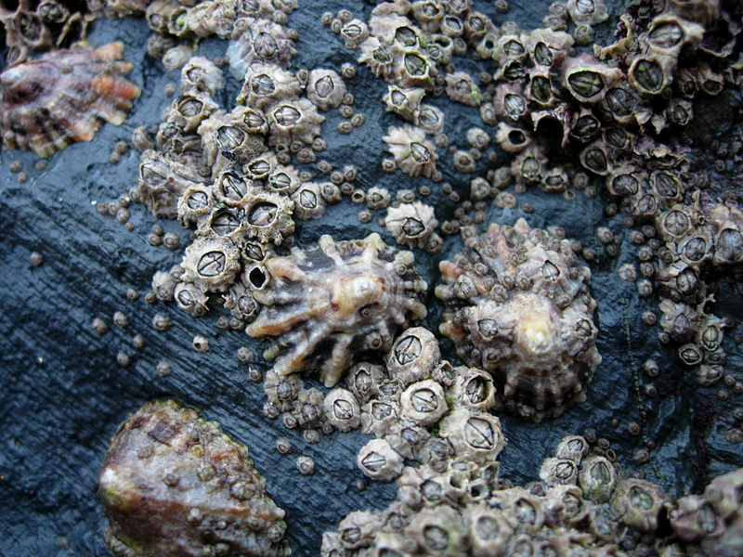
Barnacles and limpets compete for intertidal space.

Slide 21
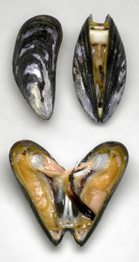
Marine Blue mussels
Benthos

Slide 22
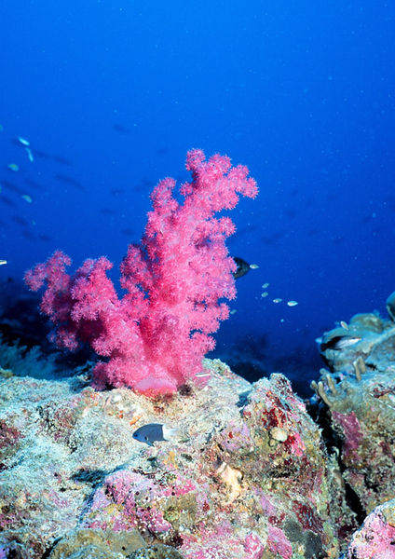
Coral reef
Found in shallow
waters.
* Deep Sea corals?

Slide 23
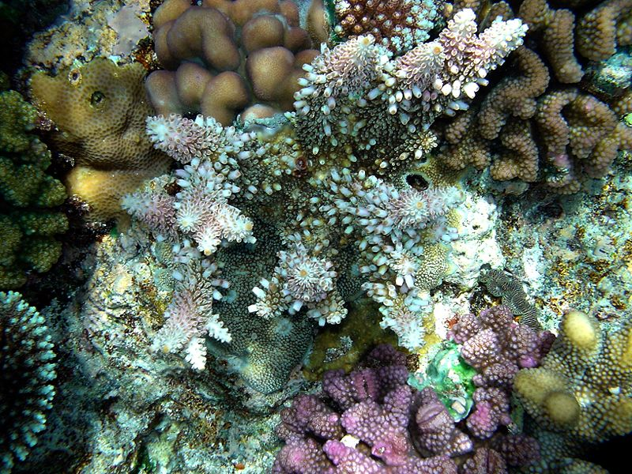
More coral in New Guinea

Slide 24
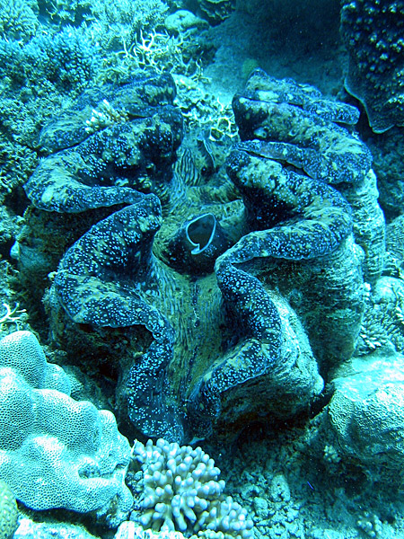
Giant clam along the Great Barrier Reef.

Slide 25
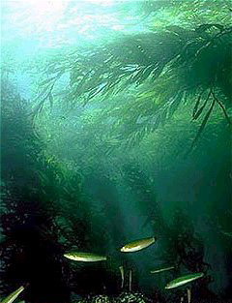
Neritic zone Edge of continental shelf
California Kelp forest
(benthos)

Slide 26
Giant Kelp in Monterey Bay aquarium

Slide 27
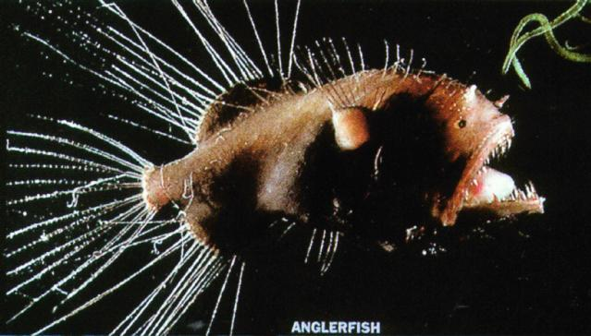
Anglerfish
Abyssal subzone

Slide 28
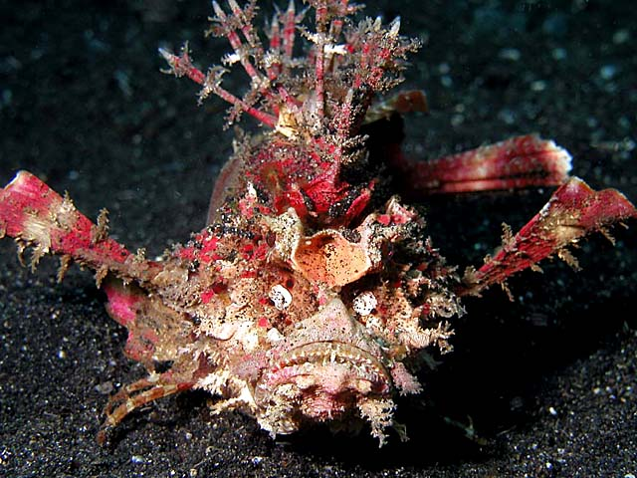
Devilfish
Abyssal subzone

