Slide 1
Weather and Climate
The Atmosphere
2.5.1Summarize information from charts and graphs regarding layers of the atmosphere, temperature, chemical composition, and interaction with radiant energy.

Slide 2
Weather and Climate… what’s the difference?
Weather is always changing and refers to the state of the atmosphere at a given time and place
Climate is based on the observations of weather conditions over many years and helps us describe a region
To understand weather and climate, we first need to understand what our atmosphere is made of

Slide 3
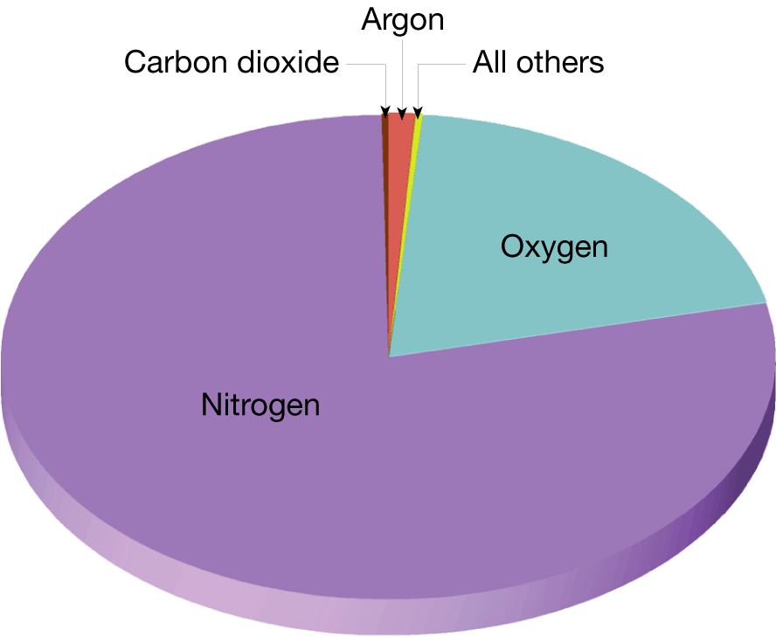
The Composition of the Atmosphere
How old is the earth? _______
Over this period of time the composition of the atmosphere has changed dramatically
“Air” is not a single gas, it is a mixture of gases

Slide 4
The Composition of the Atmosphere
The most abundant gas in the atmosphere is nitrogen
The second most abundant is oxygen
Together make up 99% of clean, dry air
Carbon dioxide is important for absorbing energy in the atmosphere
Water vapor is the source of all clouds and precipitation and absorbs heat given off by Earth

Slide 5
Composition of the Atmosphere
Ozone: a form of oxygen with three oxygen atoms bonded together instead of just two (that’s the O₂ we breathe)
Results from oxygen absorbing radiation (energy) from the sun
The ozone layer is crucial for life on Earth because it absorbs potentially harmful radiation
The ozone layer allows life on Earth to exist

Slide 6
The Composition of the Atmosphere
We just finished talking about the oceans, which contain water.
Liquids are one type of fluid
Gases are also fluids
Most of the properties of our atmosphere that influence weather, climate, and life as we know it, come from the fluid nature of the atmosphere

Slide 7
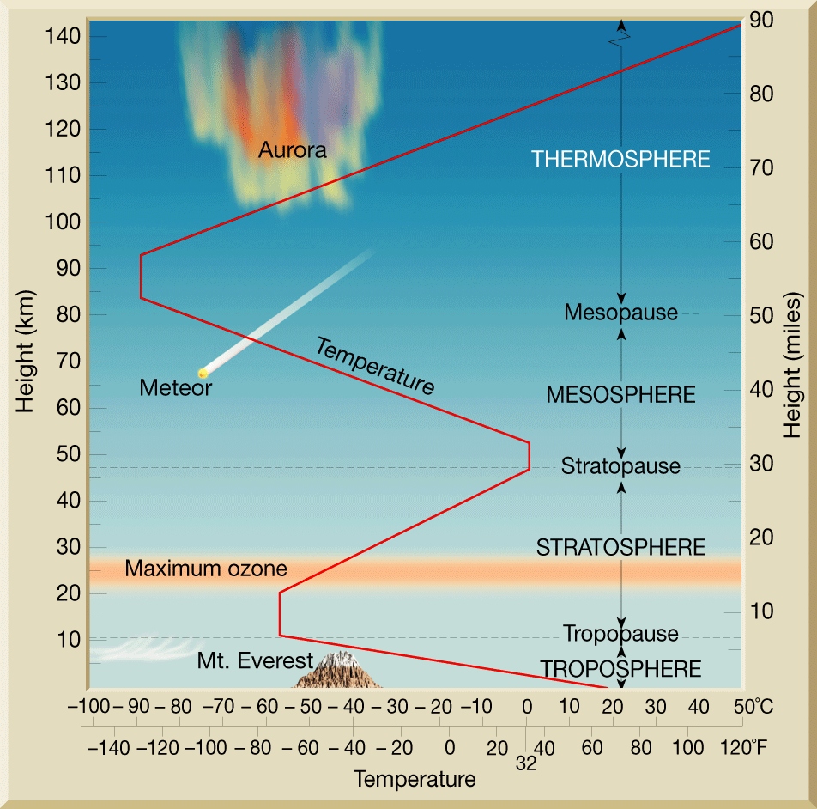
The Structure of the Atmosphere
The atmosphere thins very quickly as you travel away from Earth’s surface
The atmosphere is divided vertically into 4 layers based on temperature

Slide 8
The Structure of the Atmosphere
Layers of the atmosphere
The lowest = troposphere
Temperature decreases as altitude increases
Most important weather phenomena occur here
2nd = stratosphere
3rd = mesosphere
Top = thermosphere

Slide 9
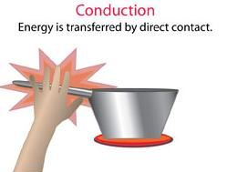

Slide 10
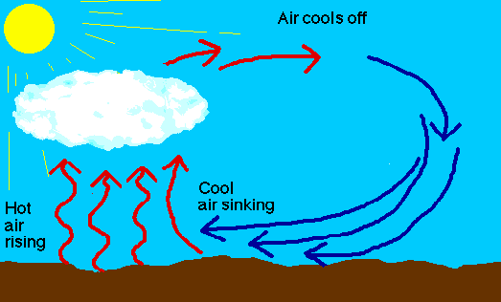

Slide 12
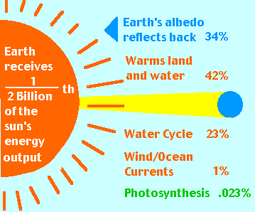
Solar Fundamentals
Atmospheric Basics
The Sun is the source of all energy in the atmosphere.
This energy is transferred to Earth and throughout the atmosphere through conduction, convection & radiation.

Slide 13
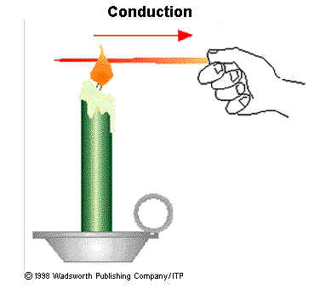
Solar Fundamentals
Atmospheric Basics
Conduction is the transfer of energy that occurs when molecules collide.
Through conduction, energy is transferred from the particles of air near Earth’s surface to the particles of air in the lowest layer of the atmosphere.
For conduction to occur, substances must be in contact with one another.
Conduction affects only a very thin atmospheric layer near Earth’s surface.

Slide 14
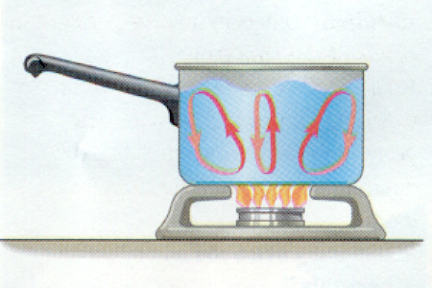
Solar Fundamentals
Atmospheric Basics
Convection is the transfer of energy by the flow of a heated substance.
Pockets of air near Earth’s surface are heated, become less dense than the surrounding air, and rise.
As the warm air rises, it expands and starts to cool.
When it cools below the temperature of the surrounding air, it increases in density and sinks.
Convection currents are among the main mechanisms responsible for the vertical motions of air, which in turn cause different types of weather.

Slide 15
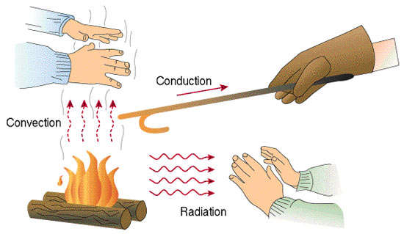
Solar Fundamentals
Atmospheric Basics
Radiation is the transfer of energy through space by visible light, ultraviolet radiation, and other forms of electromagnetic waves.
The Sun is shining on, and therefore warming, some portion of Earth’s surface at all times.
While Earth is absorbing solar radiation, it is also continuously sending energy back into space.

Slide 16
Heating of the Atmosphere
Heat vs. temperature
Heat is the energy transferred from one object to another due to differences in temperatures.
Bottom line: heat is transferred between objects because of differences in temperature

Slide 17
Heating of the Atmosphere
The heating of the atmosphere comes from solar energy
The solar energy is transferred to Earth through radiation
When radiation hits an object, three things happen
1. some radiant energy is absorbed
2. some radiant energy is transmitted through substances like water and air
3. some radiant energy bounces off the object without being absorbed or transmitted

Slide 18
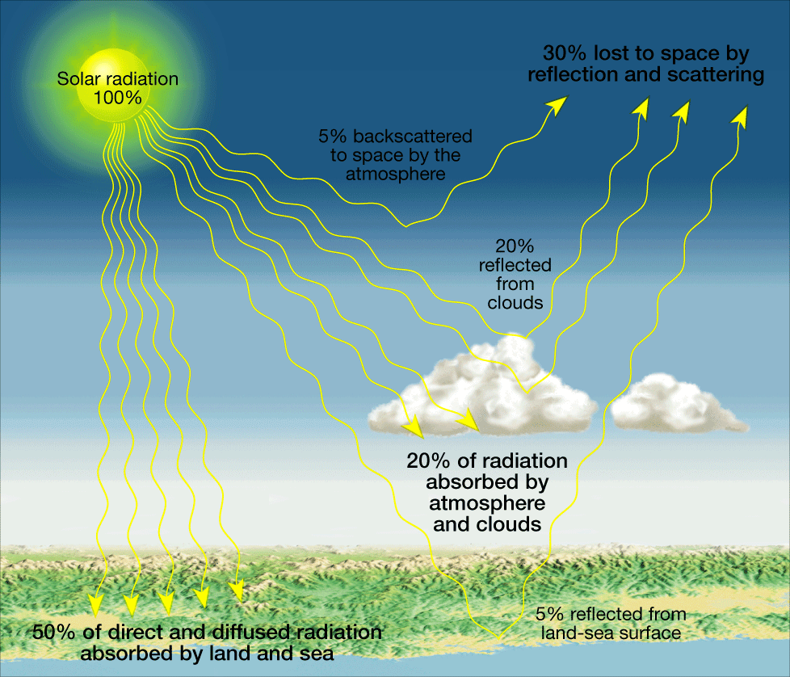
Heating of the Atmosphere
Take a look at Figure 12 on page 486 to answer the following questions
How much of the Sun’s energy that reaches Earth’s atmosphere is reflected back into space? (add together the amount that is backscattered to space, the amount reflected from clouds, and the amount reflected by the land-sea surface)
How much of the Sun’s energy is absorbed by Earth’s atmosphere and clouds?
How much of the Sun’s energy is absorbed by the land and sea?

Slide 19
Heating of the Atmosphere
If we did not have gases to absorb solar radiation, Earth would not be a place where we could live
This heating of the lower layer of the atmosphere from radiation absorbed by heat absorbing gases is called the greenhouse effect
… so just like plants grow better in a greenhouse, all life on Earth is able to flourish because of the greenhouse effect

Slide 20
Heating of the Atmosphere
The temperatures we experience are due to the amount of heating of the atmosphere above us and the ground and water around us.
Land heats and cools more rapidly than water
Land also reaches higher and lower temperatures than water
The temperature of the land and water influences the temperature of the air above it
This explains why inland areas experience greater temperature variations than cities near large bodies of water

