Slide 1
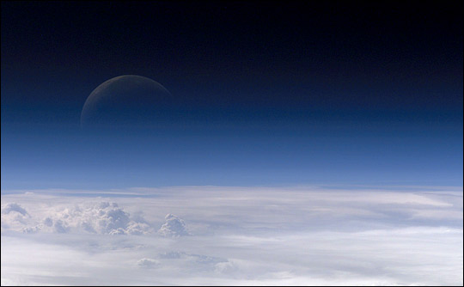
Humans impact the Atmosphere
Global Warming
Air pollution and smog
Ozone Depletion
Acid Rain

Slide 2
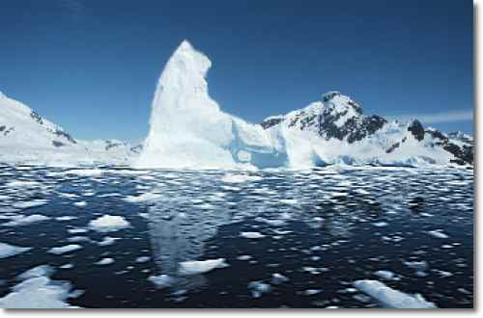
Global Warming
Aka Climate change

Slide 3
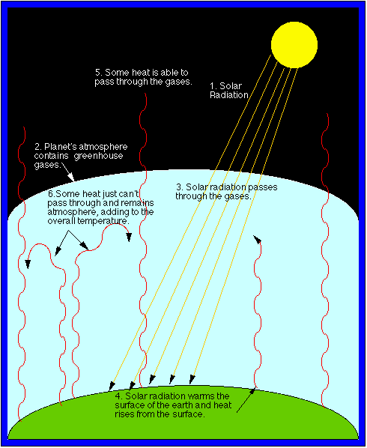
http://www.epa.gov/climatestudents/basics/today/greenhouse-effect.html
Increasing amounts of solar radiation is being trapped near the surface of the Earth because of increasing amounts of greenhouse gases in the atmosphere.

Slide 4
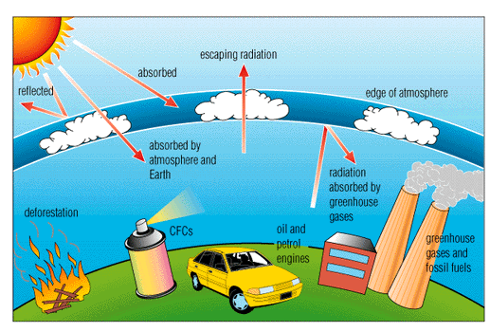
What are the contributors to an increase in CO2?
Deforestation- less trees to take up CO2 during photosynthesis
Burning of fossil fuels by vehicles and factories releasing CO2
*there are other gases besides CO2 that trap heat but this is the only one we will focus on for this class.

Slide 5
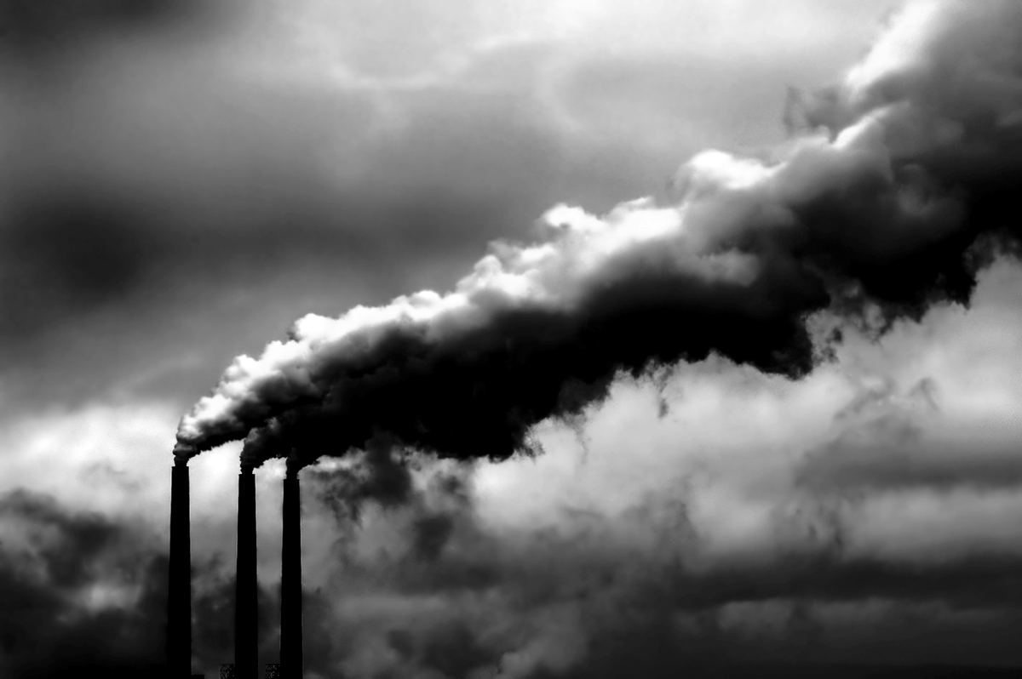
Major Greenhouse Gases
Carbon Dioxide CO₂
Water Vapor
Chlorofluorocarbons (CFC’s)
Methane CH₄
Nitrous Oxide N₂O
Perfluorocarbons (PFC’s)
Hydrochlorofurocarbons (HCFC’s)
FYI

Slide 6
The Evidence
Gas bubbles of CO₂ in ice cores samples.
Surface and air temperature records.
Changes in global sea level since 1900
Atm. concentration of CO₂ is at it’s highest in 420,000 years
20th century was the hottest in the last 1000 years
Since 1861, average surface temp. is up 4°F

Slide 7
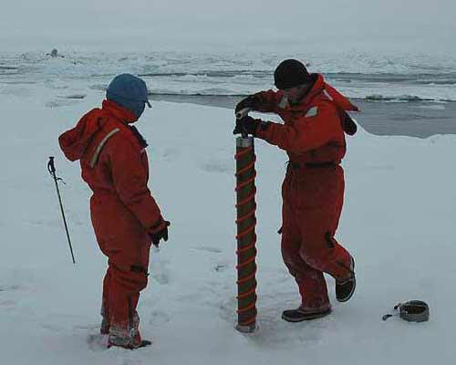
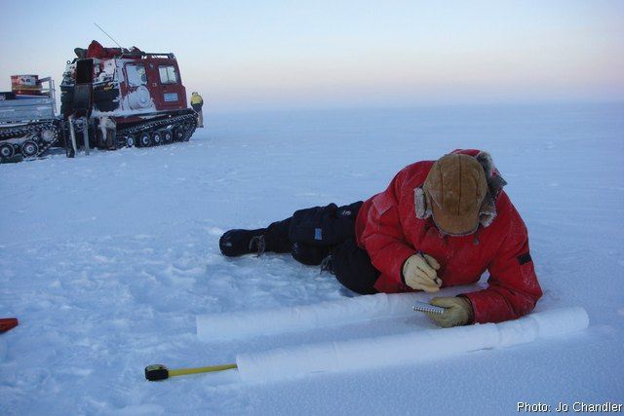
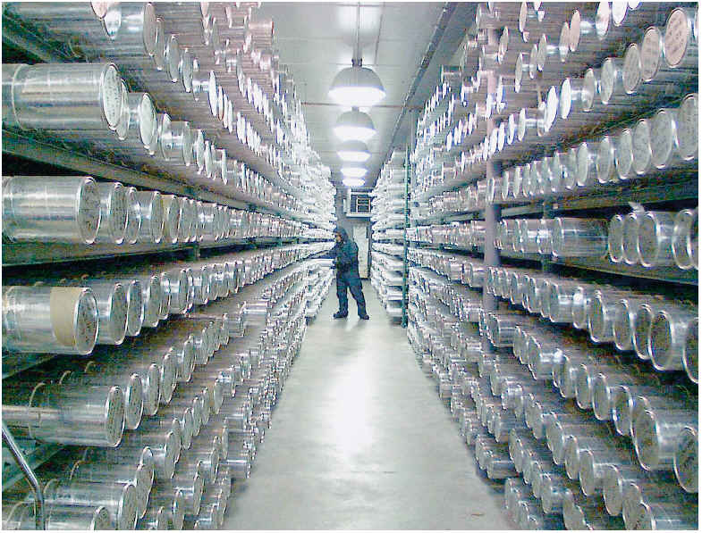
Ice Cores
Provide information about Earth’s climate thousands of years ago

Slide 8
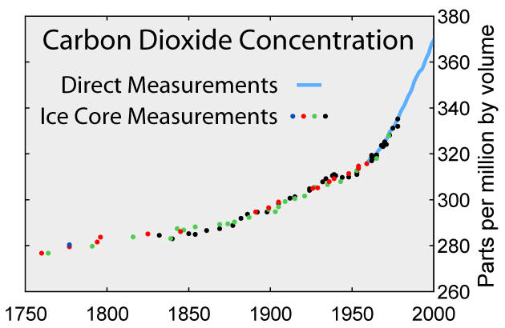

Slide 9
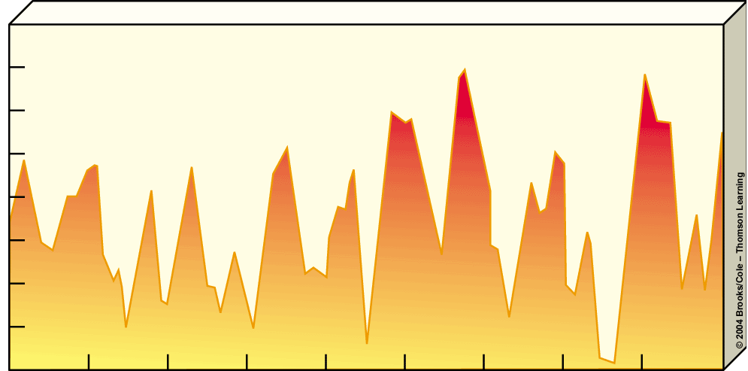
Scientists believe that the increasing amounts of greenhouse gasses has led to an increase in temperature.
Average temperature over past 900,000 years
17
16
15
14
13
Average surface temperature (°C)
12
11
10
9
900
800
700
600
500
400
300
200
100
Present
Thousands of years ago

Slide 10
Predictions for the future
1 - 3.5° C rise in Earth’s average temp. by 2100
More pronounced warming at the poles
Breaking up of the ice shelves and melting
A continued rise in global sea level

Slide 11
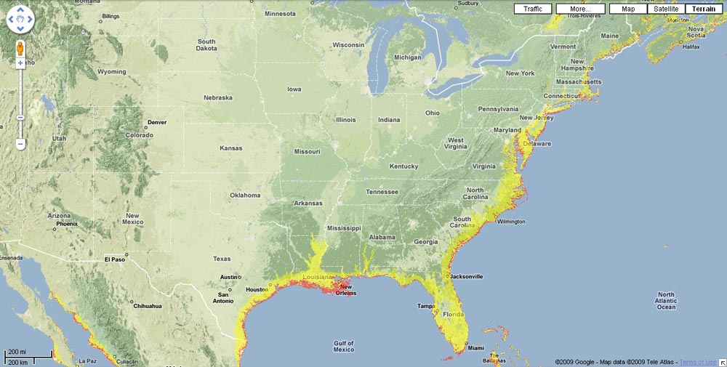
Some Scientists predict a 1 meter rise is sea level by 2100
A rise like this could significantly impact the US, especially port cities.

Slide 12
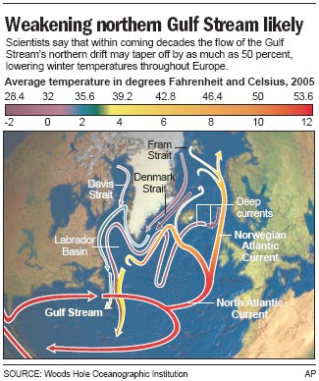
A warming of the atmosphere and ocean surface temperatures may change the route of the gulf stream and impact climate in Europe and America.

Slide 13
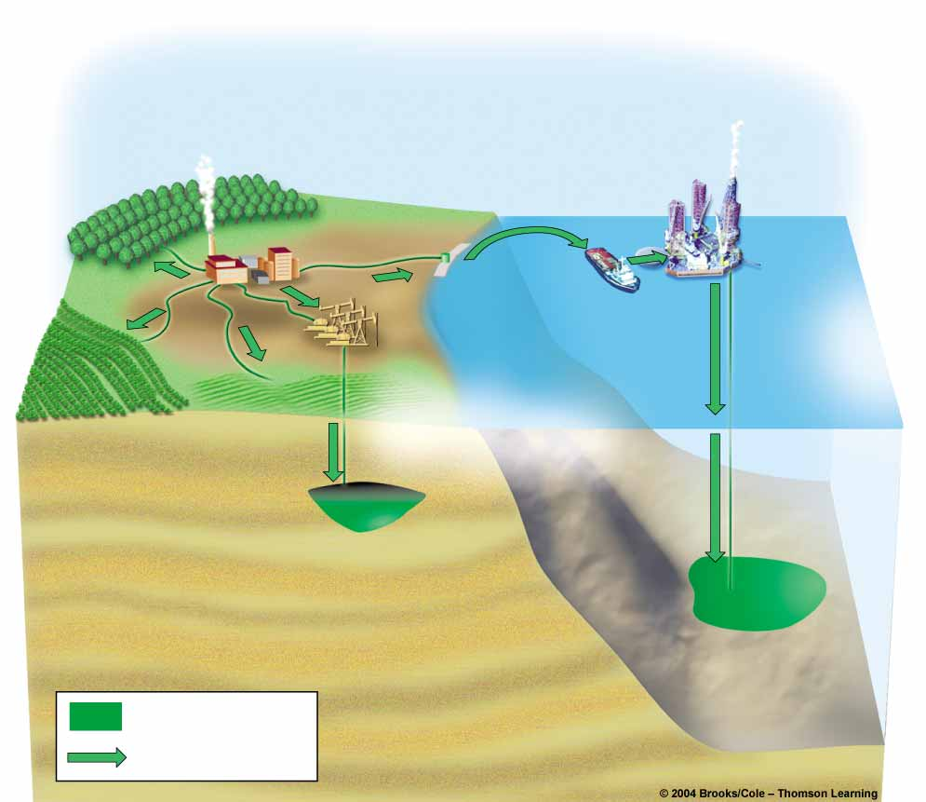
Carbon Sequestering
Tree
plantation
Coal
power plant
Tanker delivers
CO₂ from plant
to rig
Oil rig
CO₂ is
pumped down
from rig for deep
ocean disposal
Abandoned
oil field
CO₂ is pumped
down to reservoir
through abandoned oil field
Crop field
Switchgrass
field
Spent oil reservoir is
used for CO₂ deposit
= CO₂ deposit
= CO₂ pumping

Slide 14
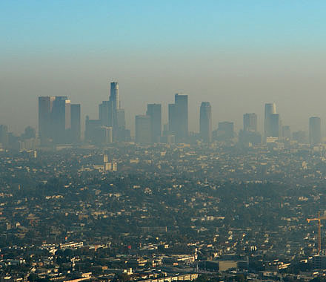
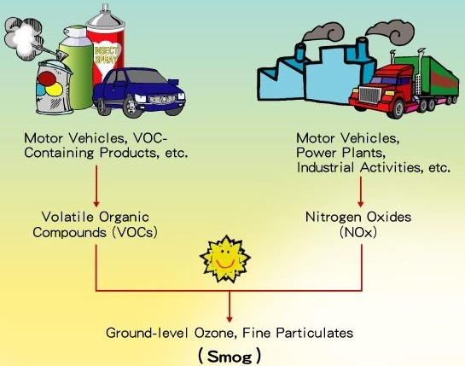
Air pollution and Smog
Smog in LA
SMOG- a mixture of sulfur, nitrogen and oxygen that reacts with sunlight to produce a smoke like haze (pollution!)

Slide 15
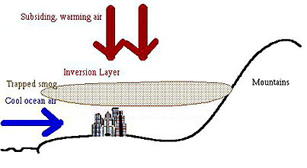
Factors that influence smog formation
Climate, topography, population density, industry, and weather
Elevation (topography) plays a role.
Smog can be trapped in a valley or lower level areas.

Slide 16
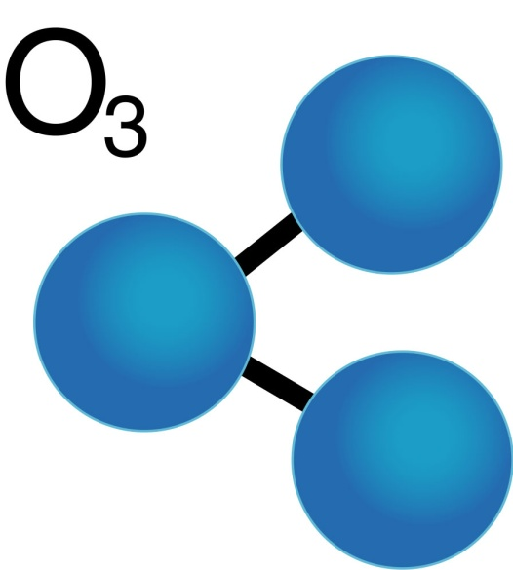
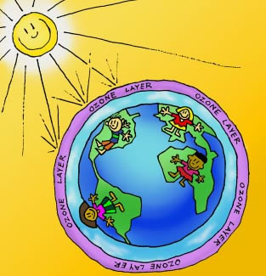
Ozone Depletion
Where is it found? Stratosphere
What is it? A gas that contains 3 oxygen molecules - O₃
Absorbs 99% of all incoming harmful UV radiation that would alter the DNA of plants and animals…ex. Causing skin cancer.
Concentrations dropped 4% globally between 1979 and 1994

Slide 17
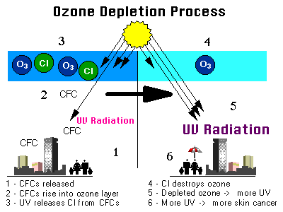
Why is it breaking down?
Air pollutants, such as chlorofluorocarbons (CFCs), enter the atmosphere and break down ozone molecules into O2 (oxygen which does NOT absorb UV rays!)
CFCs have been used as refrigerants, as propellants in aerosol sprays, and in the manufacture of plastic foams.
Areas of major ozone thinning, called ozone holes, appear regularly over Antarctica, the Arctic, and northern Eurasia.

Slide 18
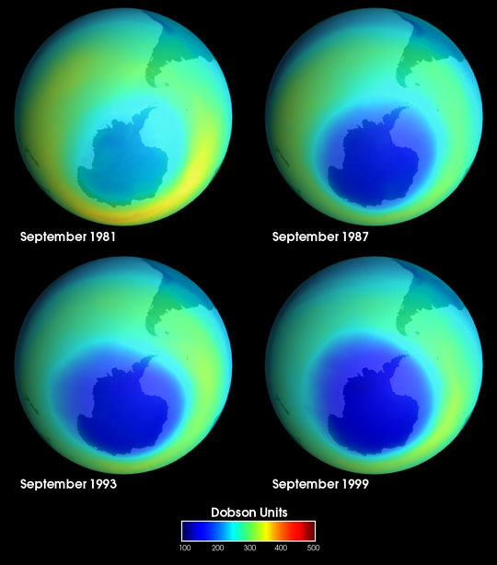
Ozone Hole
These images of the ozone hole were taken by NASA between September 1981 and September 1999.
http://veimages.gsfc.nasa.gov/138/ozone_hole.jpg

Slide 19
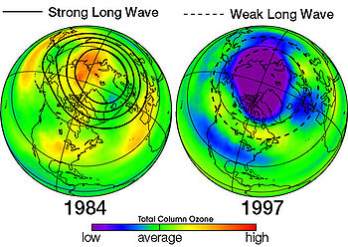
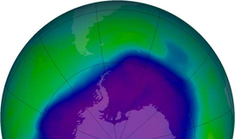
Normal Seasonal Fluctuations
S. Pole/Antarctica: Sept-Dec
  Typically a 50% reduction
N. Pole/Arctic: Feb-June
  Typically 10-38%

Slide 20
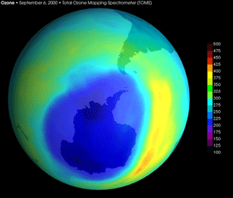
Solutions to reduce or stop ozone depletion
Vienna Convention 1985
  20 nations commit to reduce CFC use
Montreal Protocol 1987
  Reduce CFC’s by 35% by 2000
  36 nations
  London and Copenhagen 1990 and 1992
    Agreed to phase out several other substances

Slide 21

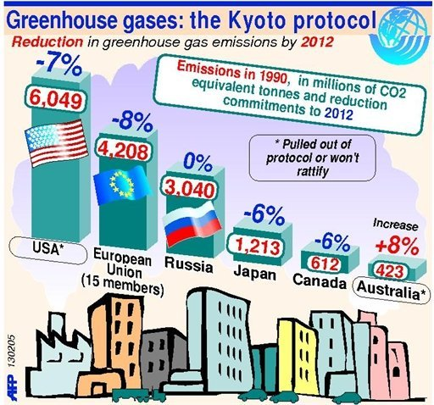
Problems
Black market for CFC’s is increasing
US legislation is not in agreement with the phase out of these chemicals.
  China, India and other developing nations did not sign the Montreal Protocol and have been increasing both production and consumption of CFC’s and other refrigerants.

Slide 22
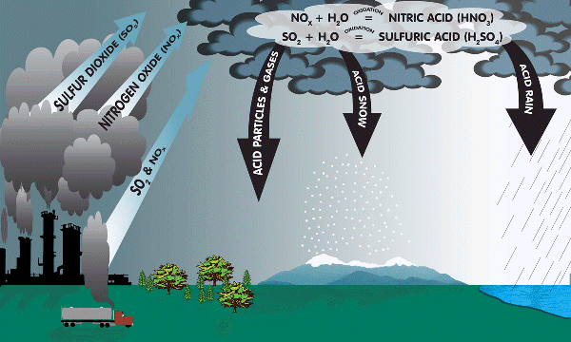
Acid Rain
The burning of fossil fuels (such as coal) and other industrial processes release into the air pollutants that contain sulfur dioxide and nitrogen dioxide.
When these substances react with water vapor, they produce sulfuric acid and nitric acid.
When these acids return to the surface of the earth (with rain or snow), they kill plants and animals in lakes and rivers and on land.

Slide 23
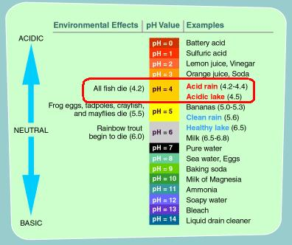
Acid Rain info
pH lower than 5.6! Natural precipitation is normally 5-5.6 because of the CO₂ in the water cycle forming carbonic acid.
Eastern US: rain is about 10 times more acidic than normal (pH 4.3)
Some North Eastern locations are as low as 2.3

Slide 24
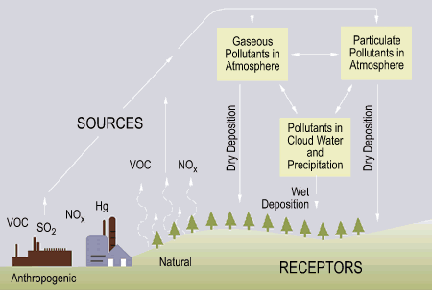

Slide 25
The Formation of Acid Rain
The rest reacts with sunlight and ozone in the atmosphere; nitric (HNO₃), and sulphuric acid (H₂SO₄₎ are produced
Some falls back to Earth close to the source as dry particles, gas and aerosols (NO_{x} and SO₂) (dry deposition)
Burn fossil fuels in
Transport, Industry, Homes, power stations
It is dissolved in the moisture in the atmosphere making
2H⁺ and SO₄^{2_}
and can be carried large distances before falling as rain or snow (wet deposition)
NO₂
SO₂
H⁺ NO₃_ SO₄^{2_}
Gas, Oil, Coal
TRANSBOUNDARY POLLUTION

Slide 26
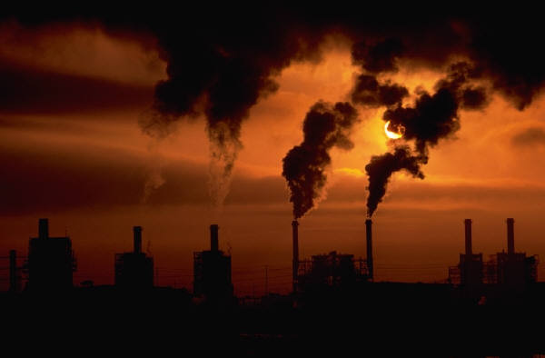
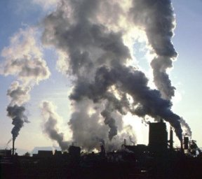


How is nitrogen and sulfuric dioxide formed?
Burning Fossil Fuels (coal, oil or gas)
When sulfur is burned it reacts with oxygen in the atmosphere and it produces Sulphur dioxide.
Sulfur dioxide dissolves in rain, making it more acidic.
It lowers its pH to 5.8
Notes:
26

Slide 27
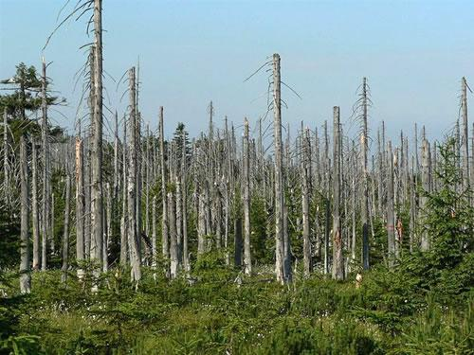
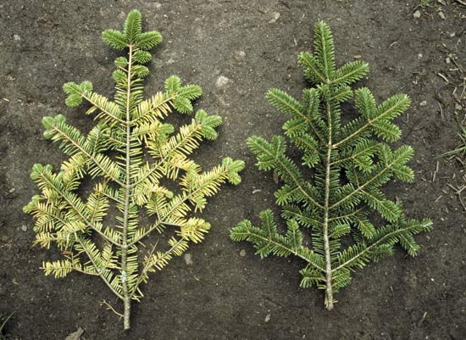
Cause and Effects
7 states in the US produce ½ the acid deposition in SE Canada and E. US
Sulfur Dioxide from Coal and Nitrogen oxides from vehicles are the primary causes.
Clean Air Act of 1990

Slide 28

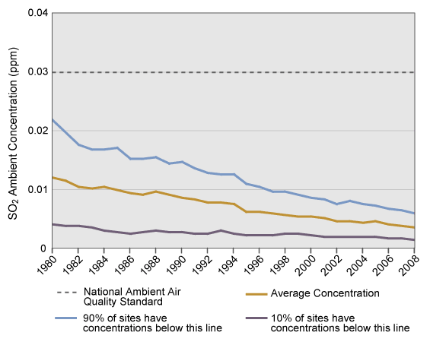
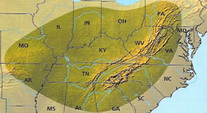
Improvements in the Appalachians since the 1980’s
National SO₂ Air Quality, 1980-2008

Slide 29
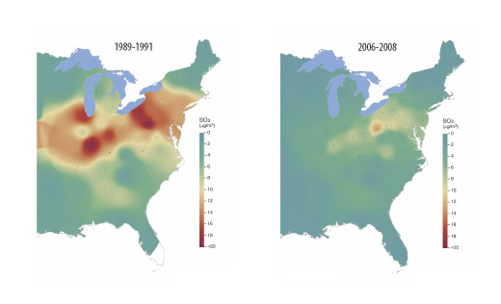
Annual Mean Ambient SO₂ Concentration

Slide 30
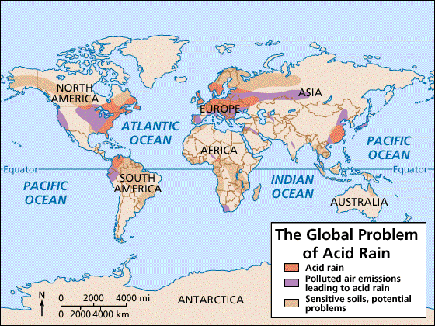

Slide 31
It is improving! The Clean Air Act
1970, 1977, and 1990
Established NAAQS or National Ambient Air Quality Standards for 7 outdoor pollutants
By 2000 coal burning power plants had cut sulfur dioxide emissions to ½ and lower and NO_{x} emissions by about 1/3
Between 1970 and 1995 most outdoor air pollutants had been decreased nationally by about 1/3

Slide 32
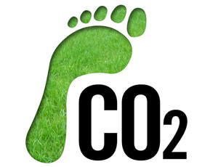
Warm UP - Constructed Response Practice
What is an ecological footprint? Why would the U.S have a larger footprint than a developing nation like India?

Slide 33
Warm up: Name the 4 categories of pollution impact on the atmosphere and the gases associated with each.
Global Warming
Smog
Ozone
Acid Rain
Increase in CO2
Sulfur, nitrogen and oxygen + sunlight
Ozone gas (O3) breaking apart by CFC compounds
Sulfur dioxide and Nitrogen dioxide (coal burning power plants)
http://www.brainpop.com/science/ourfragileenvironment/airpollution/ Brainpop

