Slide 1
Alternative Energy in NC
2.8.1B EVALUATE WHICH SOURCES OF ALTERNATIVE ENERGY MAY WORK BEST IN DIFFERENT PARTS OF THE STATE AND WHY.
Notes:
http://energync.org/assets/files/2006%20La%20Capra%20Analysis.pdf

Slide 2
NC Alternative Energy
North Carolina passed a law in 2007 to source 12.5% of its total energy from renewable sources.
First state in the Southeast to do so
$500 million dollars cheaper than meeting energy needs from coal or nuclear power

Slide 3
Why “Go Green”?
Reduction of carbon dioxide from new coal and natural gas generation
Reduction of pollutants related to air quality and health, such as nitrogen oxides, sulfur dioxide, particulate matter, and mercury, is expected.
Renewable generation facilities either do not produce waste or the waste products are less harmful than from coal and nuclear fuels.
Renewable energy resources do not have significant environmental impact from fuel extraction in contrast to the extraction impacts of coal, natural gas, and nuclear fuel.
Including energy efficiency programs will have no adverse impact on the environment.

Slide 4
Efficiency
Save money and save the environment without building new plants!
Notes:
US Army Environmental Command

Slide 5
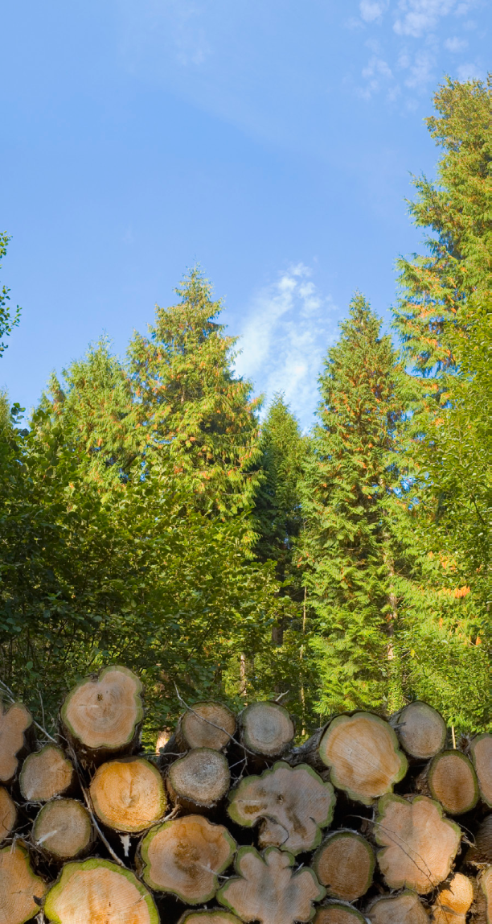
Biomass
The following guidelines have been developed for the types of wood waste that will be allowed for NCGP qualification: tree trimmings, mill residues (bark, sawdust and fines from primary processing facilities); segregated construction and demolition wood (excluding painted, treated, glued, pressurized wood or any wood contaminated with plastics or metals); clean wood waste from manufactured home plants, pallet recycling facilities, furniture manufacturers, finished building products and other similar industries; wood from land clearing that would otherwise end up in landfills; and wood bedding material removed from poultry brooder houses. Wood “chips” derived from processing whole trees within forested land will not be allowed as qualifying wood waste.

Slide 6
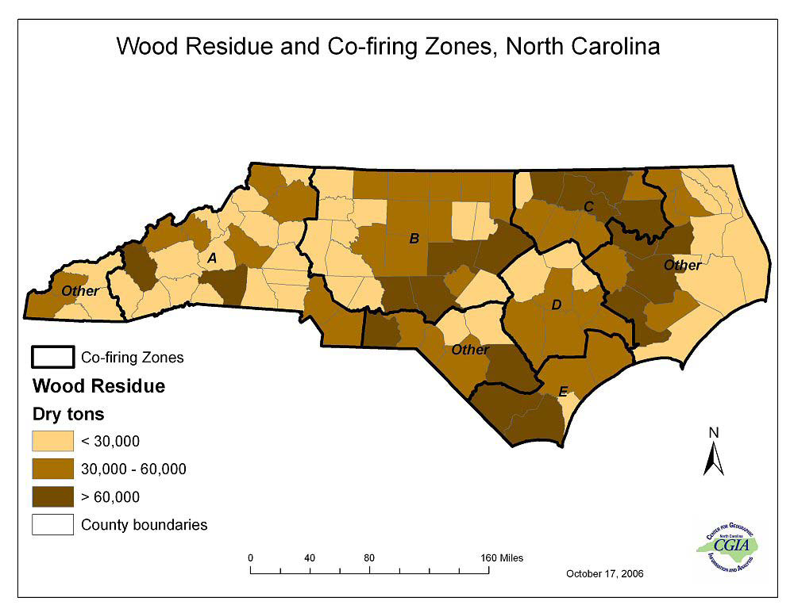
Biomass: Wood Residue

Slide 7
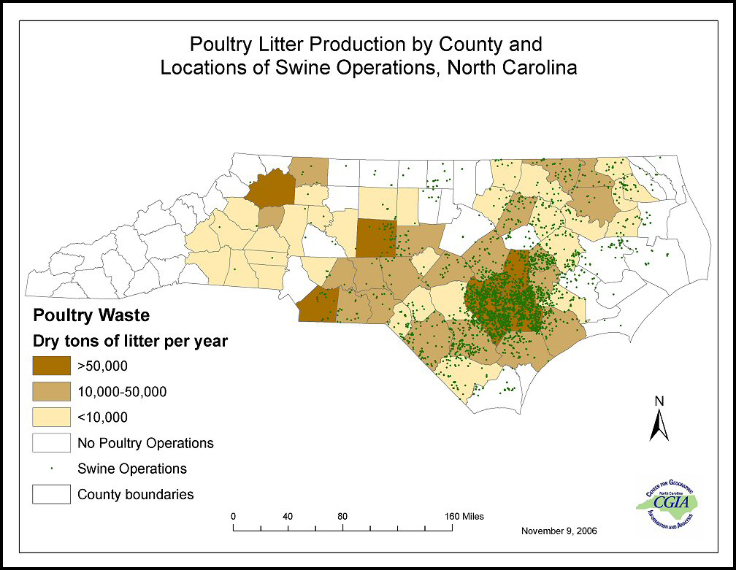
Biofuel: Animal Waste
Using animal waste to generate biogas (from decomposition of waste by bacteria)

Slide 8
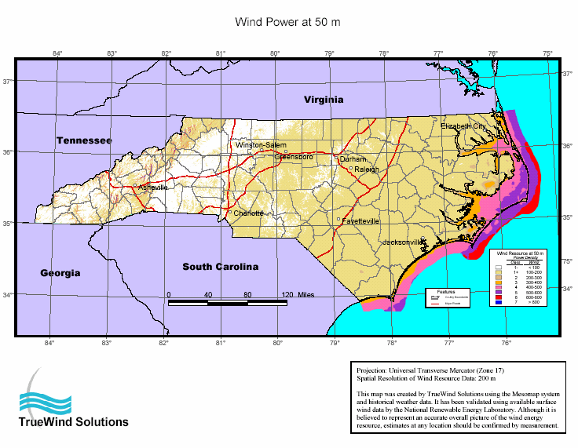
Wind Power
The State’s best wind potential can be found along the east coast and in the western mountains.

Slide 9
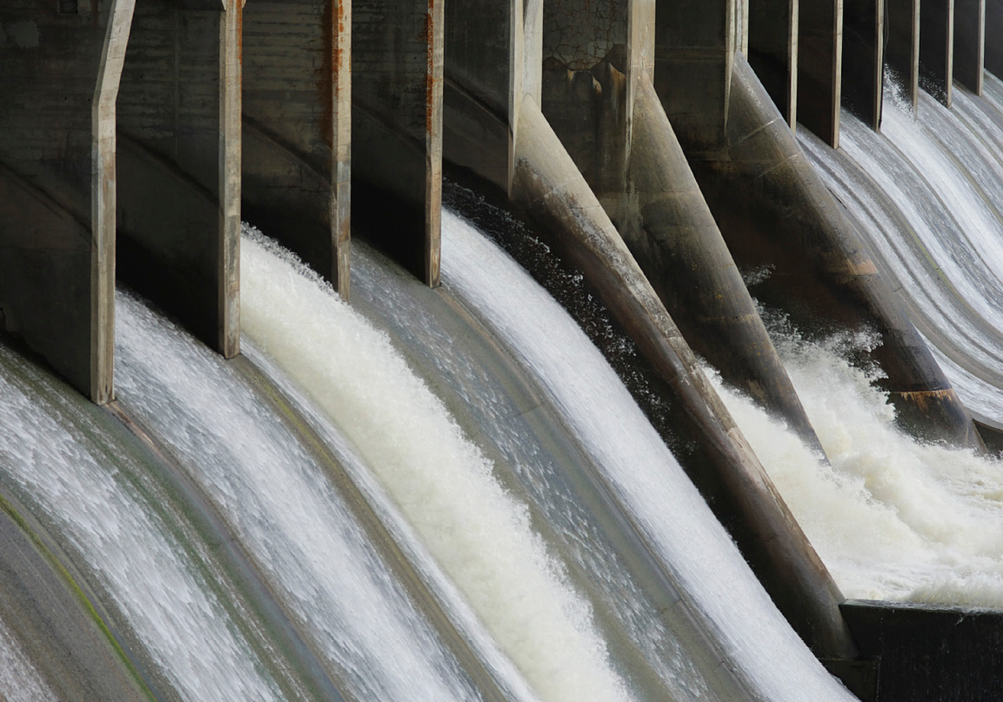
Hydroelectric
North Carolina currently has over 1,650 MW of hydropower capacity, most being utility-scale conventional hydro.
Small hydro plants have lots of potential on existing dams.

Slide 10
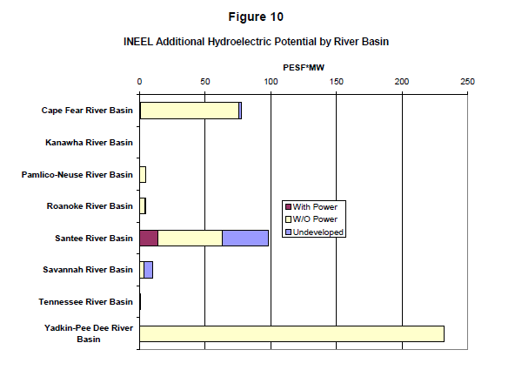
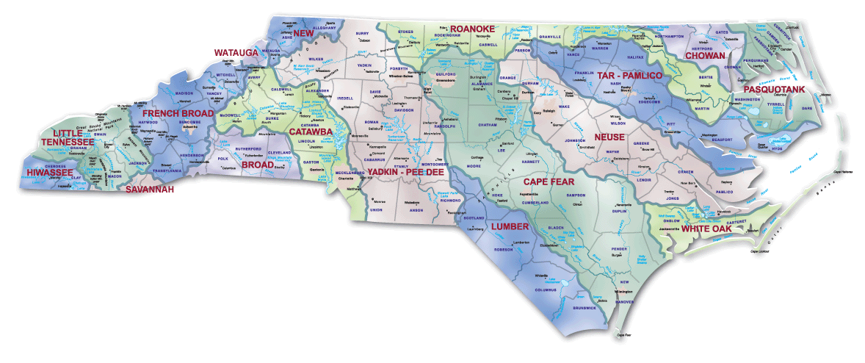
Hydroelectric on NC’s Rivers

Slide 11
Solar
Based on North Carolina’s location, the State has good solar resources throughout. Energy from the sun can be used in several ways:
Generate electricity by means of using photovoltaic (PV) systems that convert sunlight directly to electricity;
Direct thermal energy conversion either for heating or cooling applications;
Electricity generation utilizing the sun’s thermal energy.

Slide 12
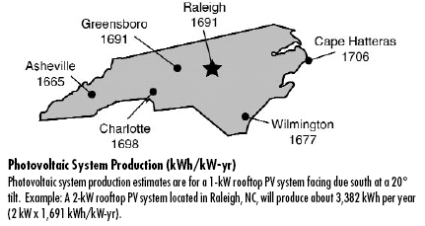
Photovoltaic System (Solar Panels) Production by Region in NC
Notes:
NCSC reported the cost of a 2 kW solar photovoltaic system (residential size) to be $20,000- $24,000 installed, or $10-$12 per watt. The cost of a larger system, 5 kW, comes to $40,000 to $50,000 or $8-$10 per watt.91 The cost quoted by installers today in North Carolina is about $10 per watt installed for residential (1-2 kW) systems.

Slide 13
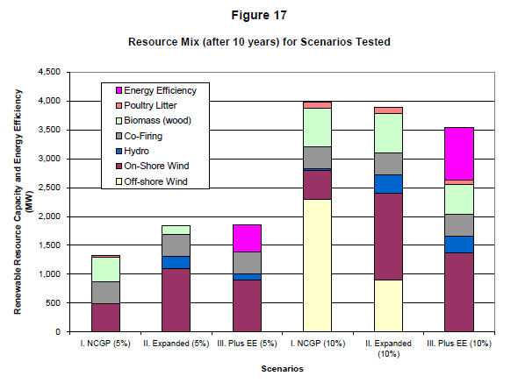
Summary
Wind has the greatest potential to produce energy in our state, especially offshore wind
Followed by biomass

