Slide 1
Greenhouse Effect
2.6.2B EXPLAIN THE CONCEPT OF THE GREENHOUSE EFFECT INCLUDING A LIST OF SPECIFIC GREENHOUSE GASES AND WHY CO2 IS MOST OFTEN THE FOCUS OF PUBLIC DISCUSSION.

Slide 2
Global Warming
All life on Earth depends on climate conditions like temperature and rainfall.
Our planet is getting warmer—the 2000s were the warmest decade ever recorded. The term used to describe this increase in the average temperature of the Earth is global warming.

Slide 3
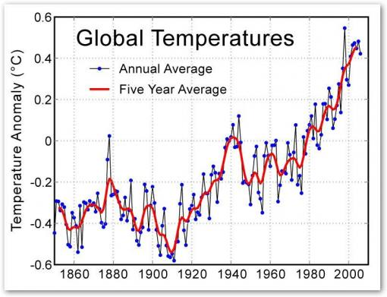
Global Warming

Slide 4
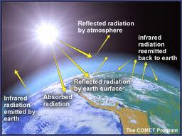
Global Warming
Scientists are trying to determine if this is a natural cycle of climate change or if it is caused by human activity.
The greenhouse effect is a natural warming of both Earth’s lower atmosphere and Earth’s surface from solar radiation being absorbed and emitted by the atmosphere.

Slide 5
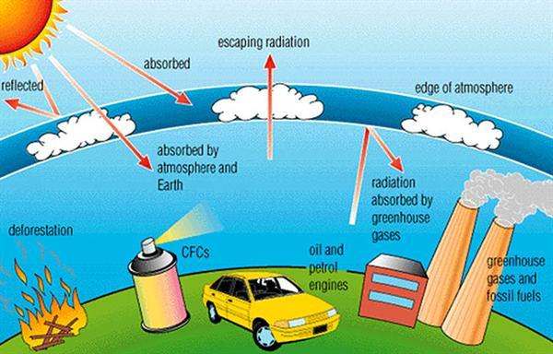
The most widely accepted hypothesis is that global warming is at least partially due to human activities that add carbon dioxide and other greenhouse gases to the atmosphere.
Other greenhouse gasses include:
water vapor (H₂O)
carbon dioxide (CO₂)
methane (CH₄)
nitrous oxide (N₂O)
ozone (O₃)
What do you think?

Slide 6
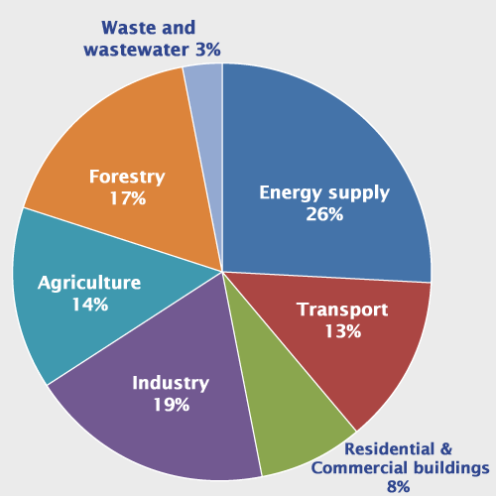
Sources of Global Greenhouse Gas Emmisions

Slide 7
Global Warming
According to this hypothesis, the burning of fossil fuels combined with cutting and burning of forests worldwide is adding carbon dioxide to the atmosphere faster than it can be removed in the carbon cycle.
This causes heat from the sun to be trapped in the air instead of being bounced back into space, which makes the planet warmer.

Slide 8
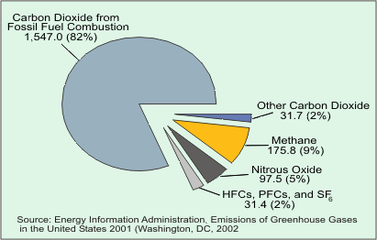
Why do we focus on CO2?
We emit more CO2 than any other greenhouse gas.
While other gasses may trap more heat, like methane, or they are harder to control (“natural sources”)

Slide 9
Acid Rain
Forms when sulfur dioxide (remember from our NASA Satellite images) and Nitrogen oxide are released into the air.
These mix in the clouds to form acid rain, which can affect the acidity of soil, harm wildlife, and pollute water sources.

