Slide 1
2.5.4c Moisture, Precipitation, and Clouds

Slide 2
Water in the Atmosphere
Water exists in three different forms.
What are they?
SOLID Examples: Snow, ice
LIQUID Examples: Rain, water
GAS Examples: Clouds, water vapor
How do each of these forms of water influence weather?

Slide 3
Water in the Atmosphere
When it comes to understanding atmospheric processes, water vapor is the most important gas in the atmosphere.
Why do you think water vapor is so important?

Slide 4
Water in the Atmosphere
Even though water vapor is important, it only makes up from 0 – 4% of the atmospheric gases.
When have you felt water vapor at close to 4%?
What about 0%?
How do you know?
Water vapor is the HUMIDITY that you feel in the air!

Slide 5
Water in the Atmosphere
What do you think the word “SATURATED” means?
What do you think it would mean if air is Saturated?
Air that has reached its water vapor capacity is said to be saturated.

Slide 6
Water in the Atmosphere
Warm, saturated air contains more water vapor than cold air
Dew point is the temperature to which air is cooled to reach saturation.
The point at which condensation can occur
When have you noticed the humidity more, in the summer or in the winter?
That’s because warm air can hold more water vapor!

Slide 7
Water in the Atmosphere
Relative humidity is the ratio of air’s water-vapor content to its capacity to hold water vapor at that same temperature.
Relative humidity indicates how near the air is to saturation, not the actual quantity of water vapor in the air.
Relative Humidity varies with temperature.
Cooling air increases its relative humidity.
Warming air decreases its relative humidity.

Slide 8
Water in the Atmosphere
Why does lowering the air temperature cause Relative humidity to increase?
Because colder air cannot hold as much water vapor!
Why does increasing air temperature cause relative humidity to decrease?
Because warm air can hold more water vapor and it will take more water vapor for it to become saturated.

Slide 9
Lifting Air
When air is compressed the air molecules move faster and the temperature rises.
Air compression causes changes in temperature even though heat isn’t added or subtracted.
When air is allowed to expand, it cools.
When air is compressed, it heats up.

Slide 10
Lifting Air
Orographic Lifting
Orographic lifting occurs when mountains act as barriers to the flow of air, forcing the air to ascend.

Slide 11
Lifting Air
How does the relatively flat areas form clouds?
Frontal Wedging
A front is the boundary between two adjoining air masses having contrasting characteristics.

Slide 12
Lifting Air
Convergence
Convergence occurs when two air masses converge. The air flows together and rises.

Slide 13
Lifting Air
Localized Convective Lifting
Localized convective lifting occurs where unequal heating on earth’s surface causes pockets of air to rise.

Slide 14
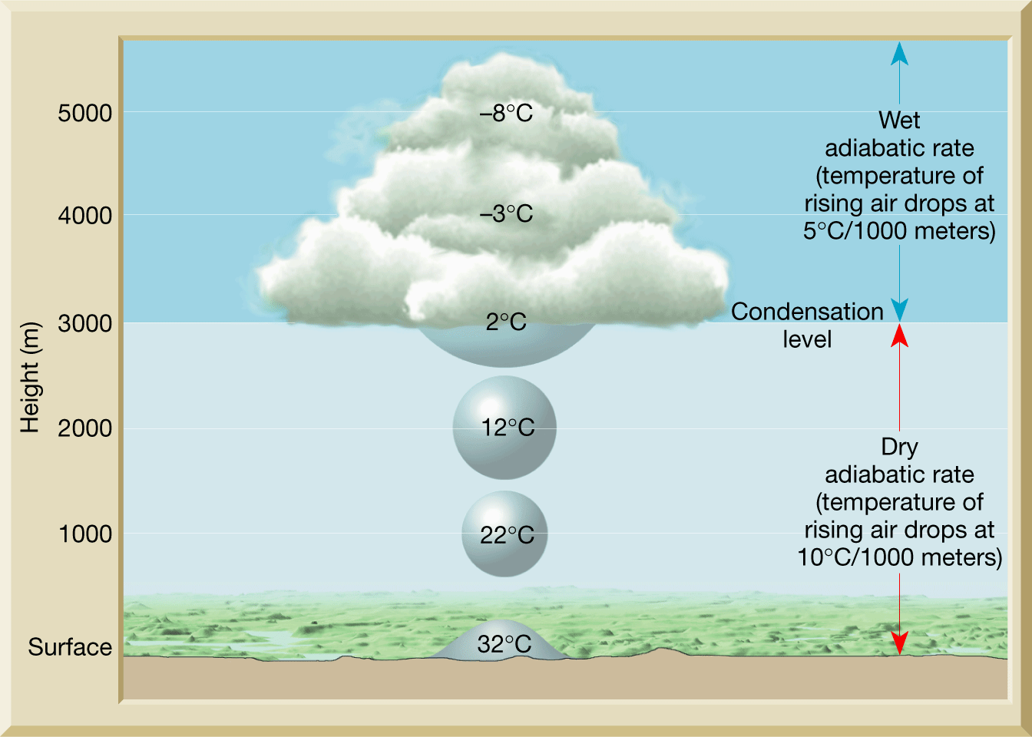
Lifting Air
Clouds form because as you go up in elevation, it gets colder.
Cold air cannot hold as much water vapor so it transforms into clouds.
Cool, expanded air
Warm, compressed air
Notes:
Using the info from yesterday, discuss how clouds form because as you go up, it gets colder. Cold air cannot hold as much water vapor so it transforms into clouds.

Slide 15
Lifting Air – Creating Clouds
When air expands to form clouds, the water vapor is transformed to clouds by condensation.
Generally, there must be a surface for water vapor to condense on.
Condensation nuclei are tiny bits of matter that serve as surfaces on which water vapor condenses when condensation occurs in the air.
Examples of condensation nuclei include dust, smoke and salt particles.

