Slide 1
Weather Patterns and Severe Storms
2.5.2B EXPLAIN HOW INTERACTIONS OF AIR MASSES FORM FRONTAL BOUNDARIES, CLOUDS, AND AFFECT WIND PATTERNS. 2.5.3A EXPLAIN FACTORS THAT AFFECT AIR DENSITY AND UNDERSTAND THEIR INFLUENCE ON WINDS, AIR MASSES, FRONTS AND STORM SYSTEMS.

Slide 2
Air Masses and Weather
Weather patterns result from the movement of large bodies of air called air masses
Air masses are characterized by similar temperatures and amounts of moisture at certain altitudes.
When air masses move, the characteristics of the air mass change and the weather in the areas over which they move changes

Slide 3
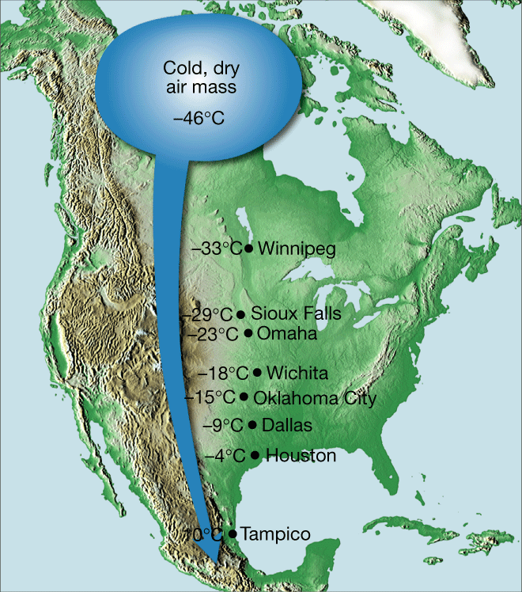
Starts off at -46⁰C
Ends up at 70⁰C

Slide 4
Air Masses and Weather
Example of air mass/weather interaction:
A cold, dry air mass moves over warm, tropical waters
The air mass becomes warmer and wetter
The weather over those waters becomes colder and drier
You try…
A warm, dry air mass moves over a cold, wet area
The air mass becomes ______________ and _______
The weather over that area becomes ____________ and ____________

Slide 5
When air masses meet… Fronts
When two air masses meet, they form a front- the boundary that separates the two
There are 4 types of fronts
Warm fronts
Cold fronts
Stationary fronts
Occluded fronts

Slide 6
Fronts
Warm fronts
Form when warm air moves into an area formerly covered by cold air
Shown on a weather map by a red line with semi-circles pointing toward the colder air
Warmer air
Colder air

Slide 7
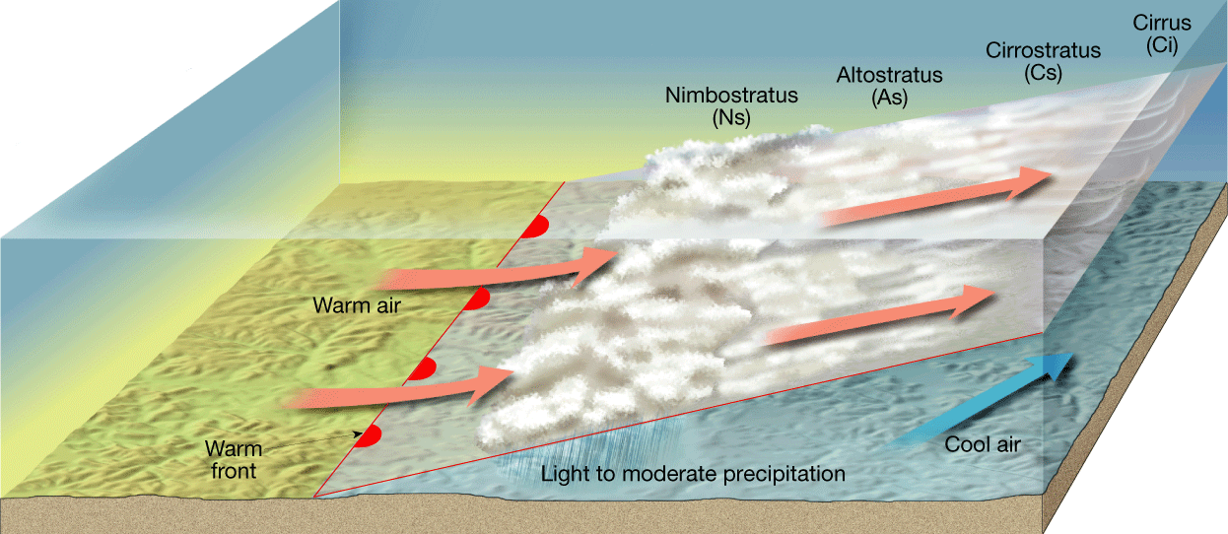
Fronts
Warm front

Slide 8
Fronts
Warm fronts
As the warmer, less dense air rises, it cools
This produces clouds and frequent precipitation
Warm fronts move slowly, so the precipitation is light-to-moderate over a large area for a long period of time

Slide 9
Fronts
Cold fronts
Form when cold, dense air moves into an area formerly occupied by warmer air
Shown on a weather map by a blue line with triangles pointing toward the warmer air
Colder air
Warmer air

Slide 10
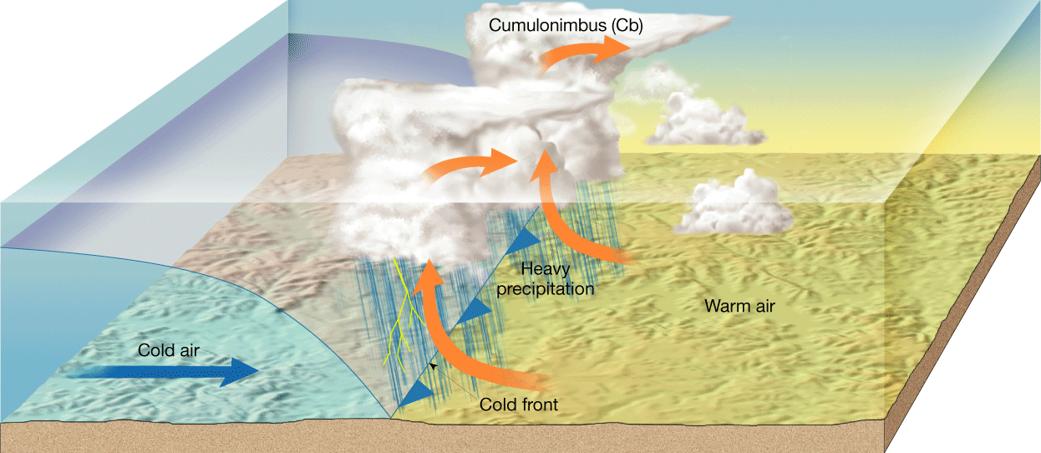
Fronts
Cold Front

Slide 11
Fronts
Cold Fronts
Move much more quickly than warm fronts
Associated with heavy precipitation that is short-lived

Slide 12
Fronts
Stationary Fronts
Form when the flow of air is neither toward the cold air mass, nor toward the warm air mass
The front does not move
Shown by blue triangles on one side and red semicircles on the other
Gentle to moderate precipitation

Slide 13
Fronts
Occluded Front
Forms when a cold front overtakes a warm front
Complex weather patterns

