Slide 1
2.4.2c Water Quality
EVALUATE WATER QUALITY OF NC STREAMS (CHEMICAL, PHYSICAL PROPERTIES, BIOTIC INDEX).
INFO FROM: HEALTHY WATER, HEALTHY PEOPLE WATER QUALITY GUIDE

Slide 2
Temperature
Definition:
Measure of the average amount of heat in the water in ºF or ºC
INCREASE may come from:
Removal of vegetation
Impoundments
Thermal pollution
Urban runoff
DECREASE may come from:
Cold water inflow
Depth

Slide 3
Temperature
Impacts
Disrupts metabolic function in cold-blooded organisms
Reduces dissolved oxygen
Increases plant and algal growth
Species shift (to more pollution tolerant)

Slide 4
pH
Definition:
Measures the hydrogen ion concentration on a logarithmic scale (no units)
INCREASE may come from (More Basic):
Photosynthesis
Mining operations
DECREASE may come from (More Acidic):
Respiration
Surrounding vegetation
Burning fossil fuels

Slide 5
pH
Impacts
Beyond normal range is unsafe to drink (pH 6.5-8.5)
Ammonia toxicity in animals at high pH
At low pH, toxic metals (aluminum) become soluble
Beyond normal range, fatally disrupts osmotic balance

Slide 6
Alkalinity
Measures water’s capacity to neutralize acids (mg/l)
INCREASE may come from:
Wastewater treatment plant effluent
Surrounding geology (weathering of limestone)
DECREASE may come from:
Acid precipitation
Surrounding geology (weathering of granite or igneous rock)
Industrial effluent

Slide 7
Alkalinity
Impacts
Low: lose buffering capacity
High: corrosive to skin and pipes
High: harmful to aquatic life

Slide 8
Dissolved Oxygen
Measures amount of oxygen dissolved in water (mg/l)
INCREASE may indicate
Aeration
Photosynthesis
Temperature (colder water can dissolve more O2 than warmer)
DECREASE may indicate
Respiration/decomposition/chemical reactions
Turbidity
Ground water influent
Elevation above sea level
Reservoir bottom-water influent
Nutrients

Slide 9
Dissolved Oxygen
Impacts
No human health impacts
Low DO causes species shifts
Potential for fish kills

Slide 10
Nitrates
Measures the organic or fertilizer matter in water (md/l)
INCREASE may indicate
Nutrients (runoff from agricultural land, lawns, etc)
Human and animal wastes
Burning of fossil fuels
DECREASE may indicate
Nutrient-free influent water
Plant use

Slide 11
Nitrates
Impacts
Human:
Increased crop quality, yield
Baby blue syndrome
Environment:
Less area needed for crops
Eutrophication of ponds and lakes

Slide 12
Phosphates
Measures the organic or fertilizer matter in water
INCREASE may indicate:
Surrounding geology (mineral apatite)
Human and animal wastes
Nutrients
DECREASE may indicate:
Nutrient-free influent water
Plant use

Slide 13
Phosphates
Impacts
Human health: Disrupts wastewater treatment
Eutrophication
Decreases dissolved oxygen levels
Shift from aerobic to anaerobic bacteria
Shift to pollution tolerant species
Algal blooms/mats

Slide 14
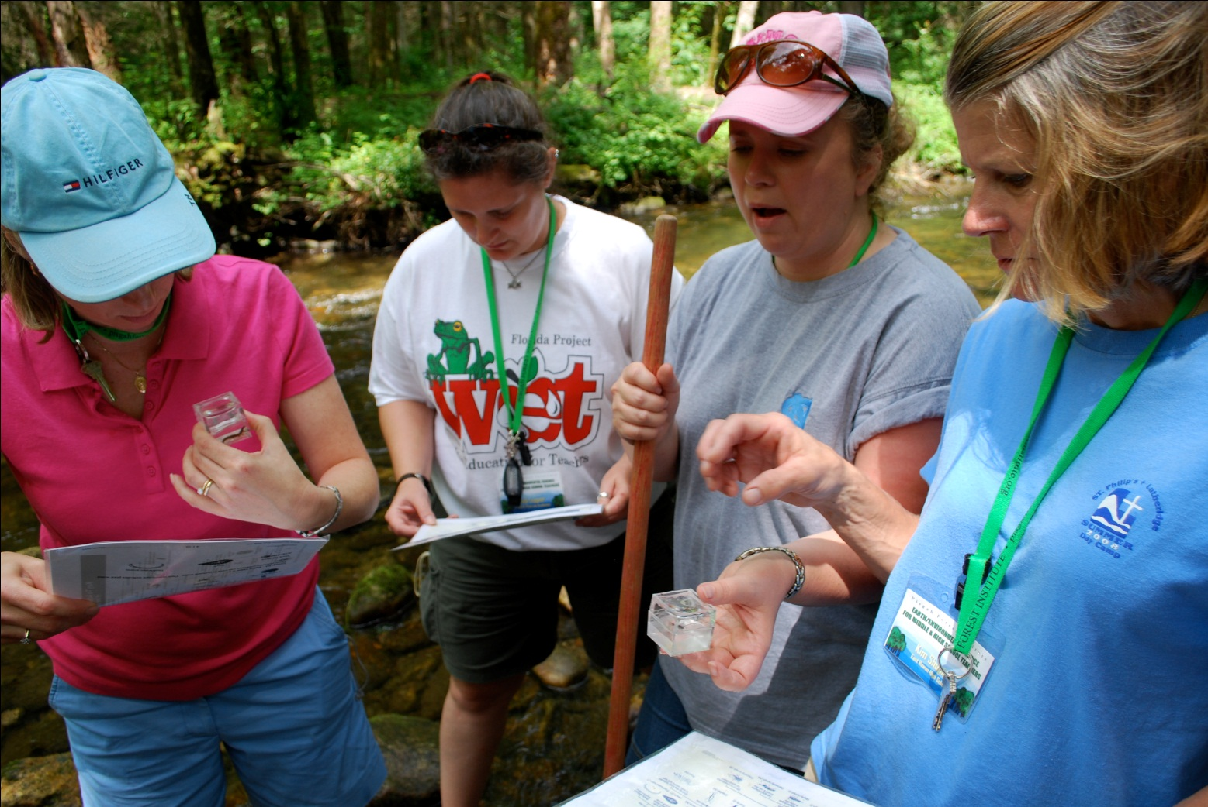
Biotic Index

Slide 15
Biotic Index
Tolerant organisms thrive in polluted streams.
Examples:
Rat-tailed maggots
Midge larvae

Slide 16
Biotic Index
Macroinvertebrates are an important part of wetland and stream ecosystems.
May spend all or part of their life in water
Immature phases (larva and nymphs) are spent entirely in water.

Slide 17
Biotic Index
Intolerant organisms are sensitive to changes in stream conditions from pollutants.
Some will leave to find a better habitat, but others will die or be unable to reproduce.
Examples:
Mayfly nymph
Stonefly nymph
Caddisfly larvae

Slide 18
Biotic Index
Intermediate organisms prefer good stream quality, but can survive polluted conditions.
Examples:
Dragonfly nymphs
Damselfly nymphs

