Slide 1
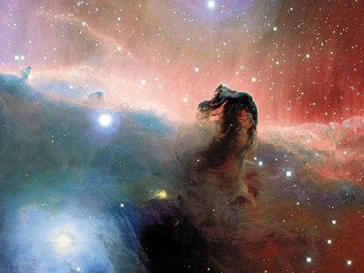
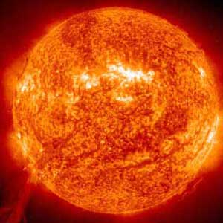
The Sun and the Universe

Slide 2
The Sun!
Distance Away from Earth:
93 million miles→ 1 astronomical unit (1 AU)
Composition: Hydrogen and Helium
Hydrogen atoms used to complete nuclear fusion into Helium atoms

Slide 3
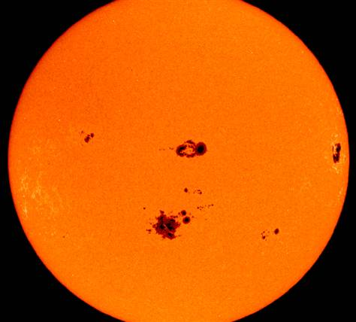
Sunspots
Sunspot: temporary areas on the surface where there is less magnetic field, therefore less convection, and a cooler area.

Slide 4
Solar Flares
Solar Flare:
Powerful bursts of radiation
Cannot penetrate Earth’s protective magnetic field
Can impact satellites and therefore GPS signals

Slide 5
You could line up 109 Earth’s at the Sun’s equator.
The Sun is a medium sized star.

Slide 6
Nebula: Birthplace of Stars

Slide 7
Planetary Nebula: Form planets

Slide 8
Stages of a Star

Slide 9
Supernova taken two months apart

Slide 10
Table:
 | Fission | Fusion
Definition

Slide 11
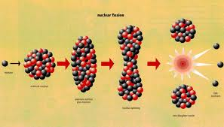
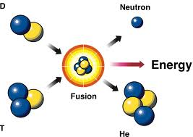
Definition
Fission is the splitting of a large atom into two or more smaller ones.
Fusion is the fusing of two or more lighter atoms into a larger one.
Fusion demo

Slide 12
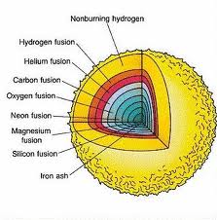
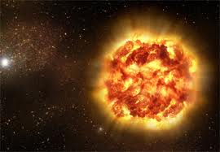
Natural Processes
Fission reaction does not normally occur in nature.
Fusion occurs in stars, such as the sun.

Slide 13
Energy Requirements
Takes little energy to split two atoms in a fission reaction.
Extremely high energy is required to bring two or more protons close enough that nuclear forces overcome their electrostatic repulsion.

Slide 14
Energy Released
The energy released by fission is a million times greater than that released in chemical reactions; but lower than the energy released by nuclear fusion.
The energy released by fusion is three to four times greater than the energy released by fission.

Slide 15
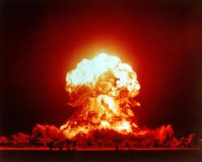
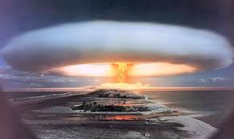
Nuclear Weapons
One class of nuclear weapon is a fission bomb, also known as an atomic bomb or atom bomb.
One class of nuclear weapon is the hydrogen bomb, which uses a fission reaction to "trigger" a fusion reaction.

Slide 16
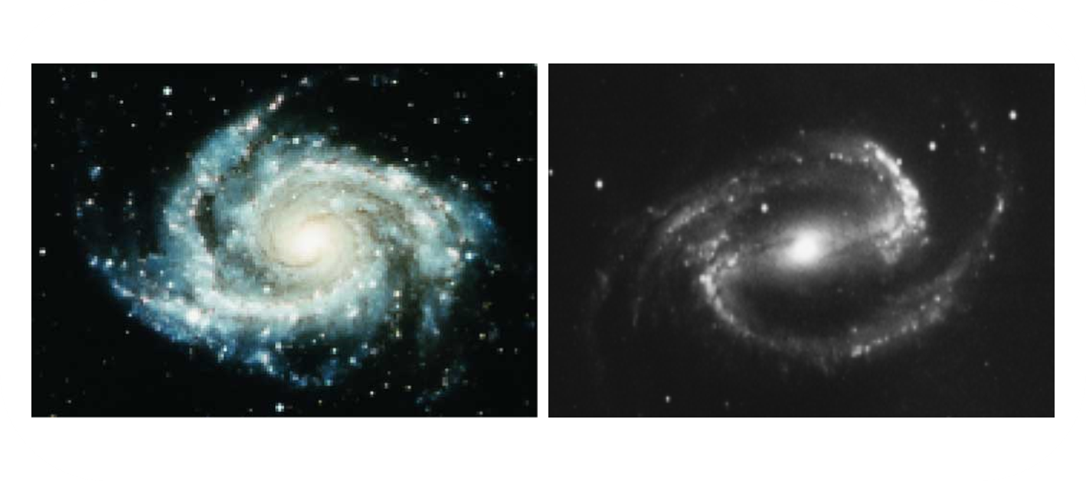
Spiral Galaxies
About 30 % of all galaxies are spiral galaxies
They have large diameters of 20,000 to 125,000 light-years and contain both young and old stars

Slide 17
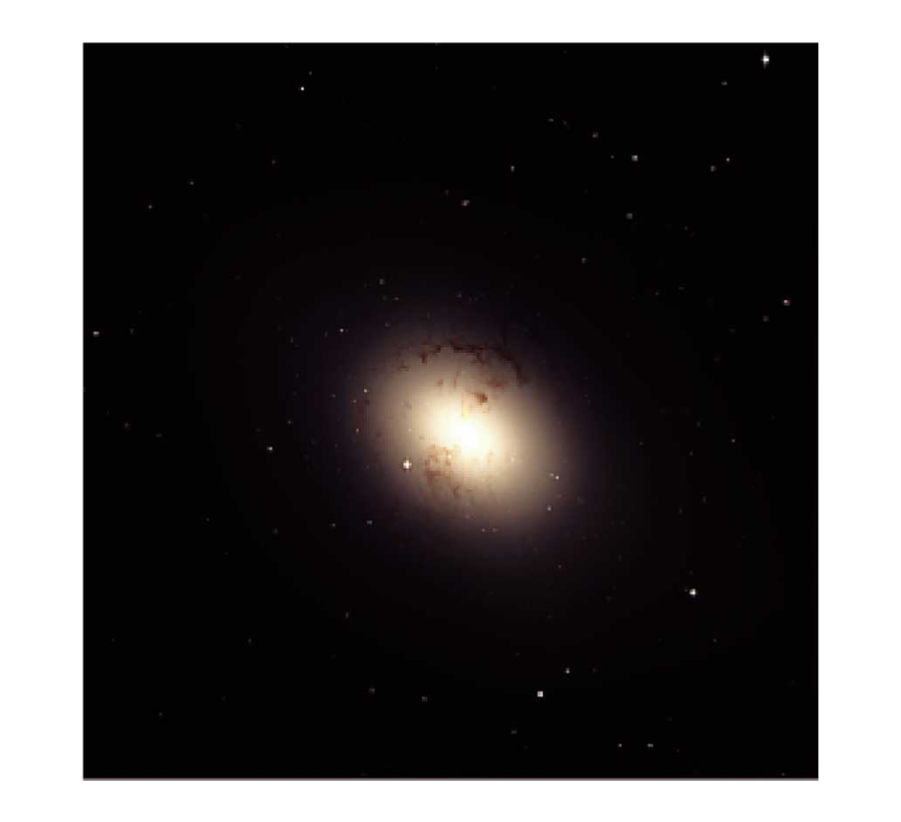
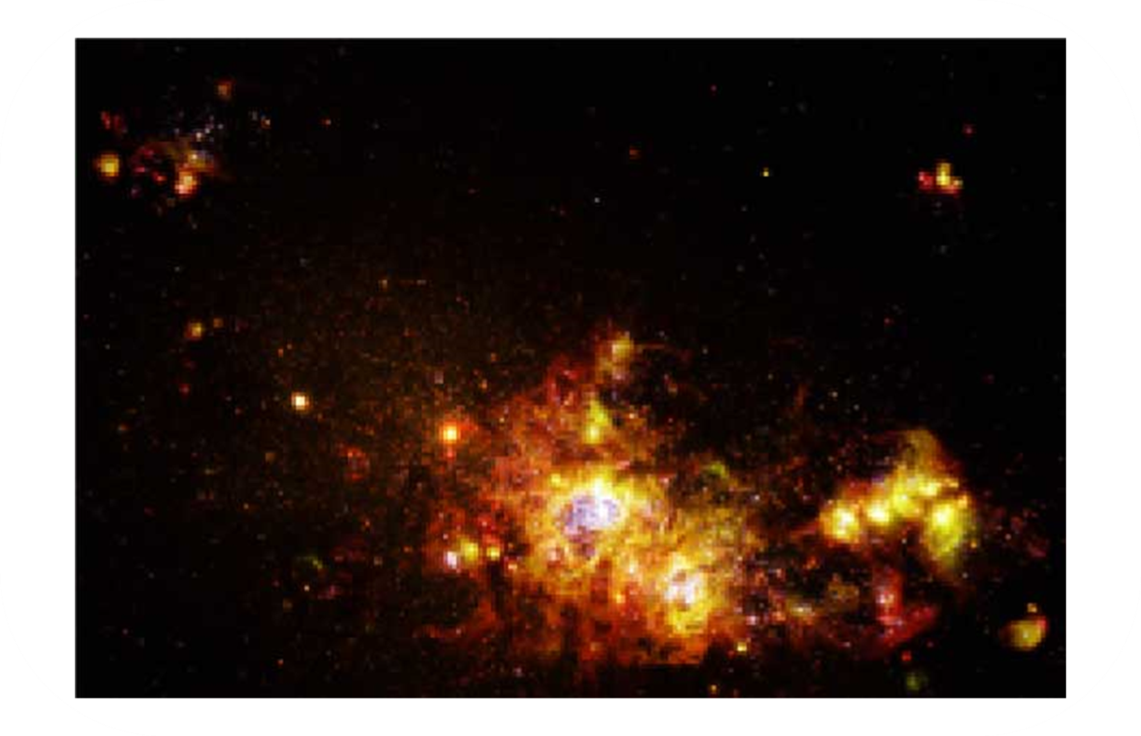
Galaxies
There are also elliptical and irregular galaxies.
Galaxies can exist in groups called galaxy clusters.

Slide 18
Galaxy Cluster!!

Slide 19
Big Bang Theory
The big bang theory states that at one time, the entire universe was confined to a dense, hot, supermassive ball. Then, about 13.7 billion years ago, a violent explosion occurred, hurling this material in all directions.

Slide 20
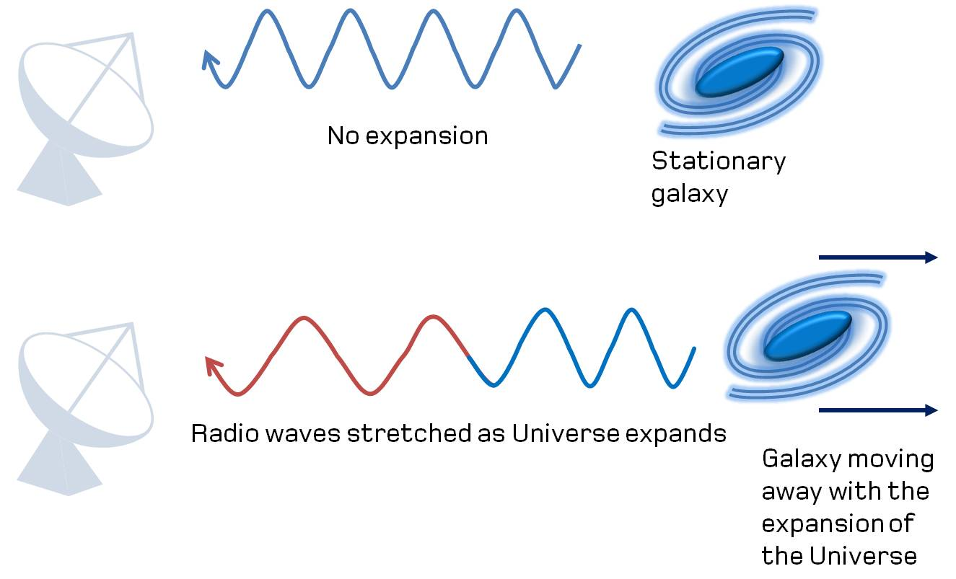
Evidence for the Big Bang Theory
The red shift of galaxies supports the big bang and the expanding universe theories.

Slide 21
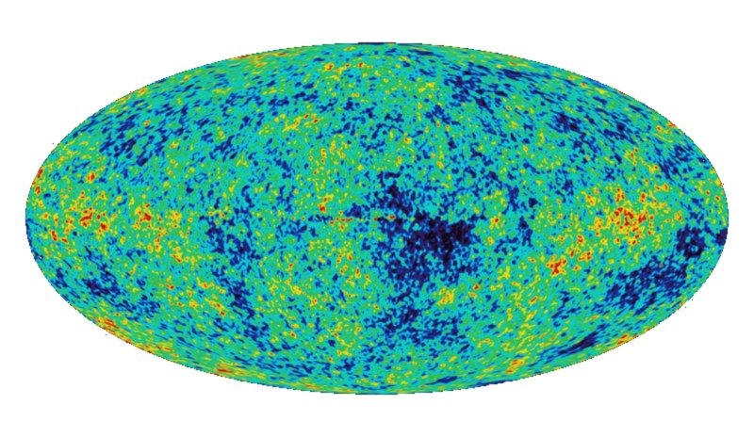
Evidence Continued
Scientists discovered a type of energy called cosmic background radiation. Scientists think that this radiation was produced during the big bang.

Slide 22
The Future of the Universe
The universe could expand forever.
The universe could stop expanding and gravitational contraction could follow.
The view currently favored by most scientists is an expanding universe with no ending point.
It should be noted, however, that the methods used to determine the ultimate fate of the universe have substantial uncertainties.

